Slide 1
All Energy: Speed and scale ZONING: Breaking down the challenge and getting moving on heat and energy efficiency
Charlotte Owen
Policy Manager

Slide 2
Who we are
We are the leading trade association for decentralised energy, representing more than 160 organisations from across the industrial, commercial and public sectors.

Slide 3
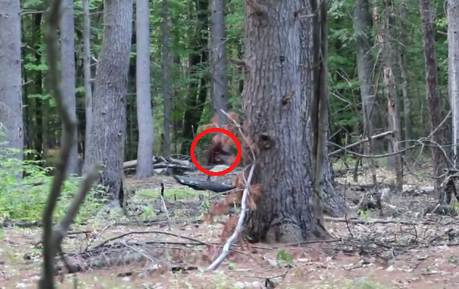
What do all these have in common?
This Photo by Unknown Author is licensed under CC BY

Slide 4
29 Million Homes
Notes:
You can see why the silver bullet is attractive when you look at the scale of the problem. And this is just homes. Non-domestic buildings will have to decarbonise too.
85% on gas

Slide 5
Myth busting the silver bullet
Heat is inherently local – and different areas of the UK will have different pathways for decarbonisation.
Different areas of the UK will be able to decarbonise at different rates, to different targets.
Notes:
Only have to look at CCC recommendations to realise this
Net zero isn’t about every single home becoming carbon neutral or net zero, it’s about every single home doing as much as they can within the means that they have.

Slide 6
Some areas already have clear decarbonisation pathways
We must enable those that can move early to do so

Slide 7
Why don’t local authorities move?

Slide 8
ZONING (local heat pathways)
Energy masterplanning and local planning
Consultation (e.g. with DNOs, GDNs, neighbouring local authorities, local community, decentralised energy, etc. – consider what is the most cost-effective solution under a whole systems perspective?)
Map opportunities in the area e.g. waste heat, geothermal
Identify most appropriate solution in line with key principles
→ In zoning an area, make it benefit from policies specifically designed to encourage that technology to come forward

Slide 9
Moving from the distress situation….
My boiler has broken down! What do I do?! I’d best replace it.
Notes:
Local planning enables us to move from this…

Slide 10
…To the planned in-home transition
I’ve got a plan for replacing my boiler, and I’ve been improving the energy efficiency of my home ready for low carbon heat. My local authority and national government are able to support me to enact my plan. And the local workforce is tailored to deliver what I need.

Slide 11
Zoning for Heat and Energy Efficiency
Zoning
Clear pipelines
Consumer Engagement
Targeted support

Slide 12
(Some of) The Asks
A specific team and deputy director / head responsible for retrofit policy within BEIS, MHCLG and Scottish Government
Begin a rigorous consumer engagement and awareness campaign, in line with COVID-19
Acknowledge that there is no single-technology / fuel pathway to net zero – and enable local areas that can move now, to do so
Consider zoning as part of the Heat & Buildings Strategy (Westminster) / Heat Decarbonisation Roadmap (Scotland)

Slide 13
Contact Us
To discuss policy:
charlotte.owen@theade.co.uk
For more information:
www.theade.co.uk
To discuss membership:
john.bryant@theade.co.uk

