Slide 1
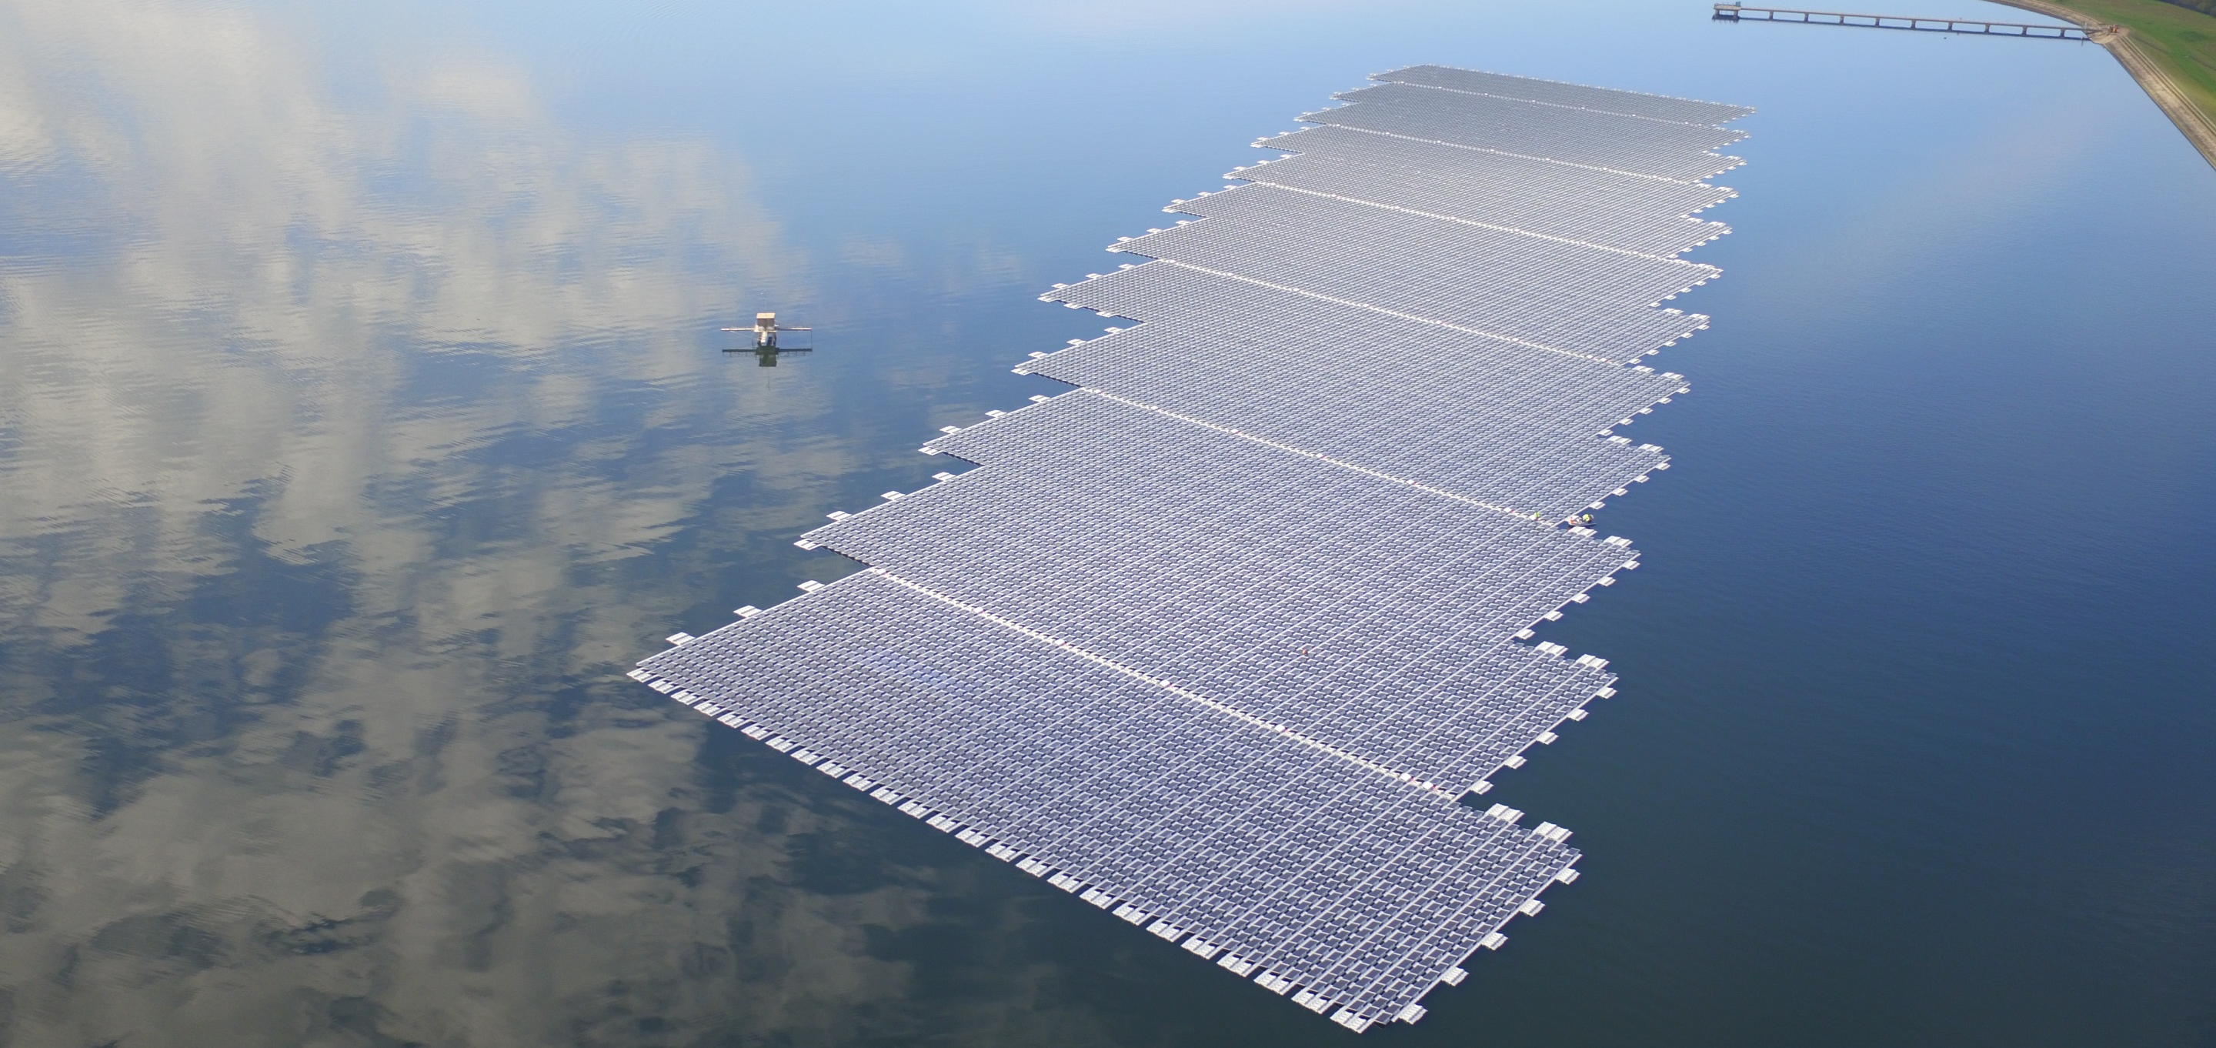
Source: Lightsource BP
Floating Solar PV
Michele Tagliapietra – DNV GL

Slide 2
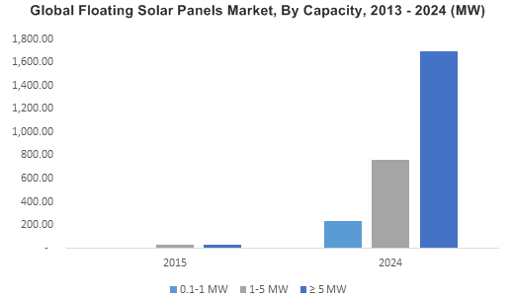
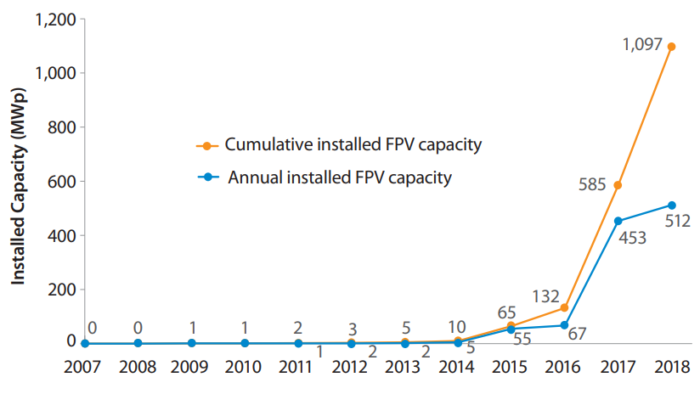
Status of the Floating PV market
First Floating Solar PV applications date back to >10 years ago, with small pilot projects in US, Japan, Italy and Spain
Floating Solar PV started booming in 2014-2016, driven by growing floating structure suppliers in Europe and Japan
Back in 2015, the FPV market was expected to grow to 2.5 GWp by 2024
Since 2016, the Asian market took the lead in large-scale Floating PV installations
2.4 GWp cumulative were installed at the end of 2019
Pipeline for more than 10 GWp in the next 3-4 years, mainly in Asia
Biggest project installed: 150 MWp, for now…
Source: GMinsights (2015)
Source: World Bank Group, ESMAP, SERIS (2018)

Slide 3
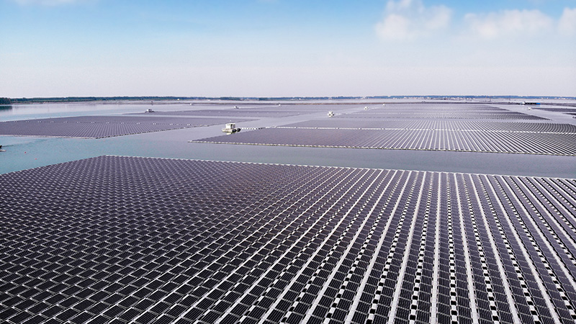
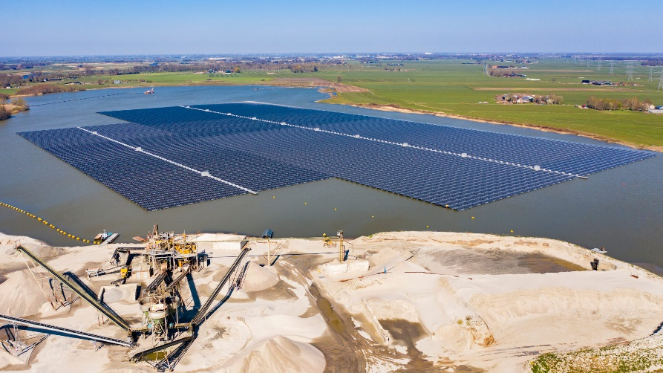
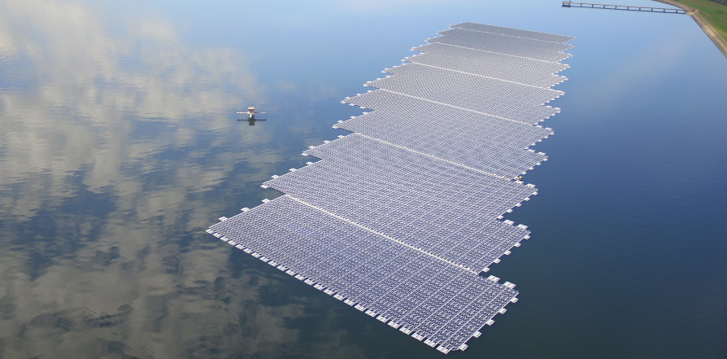
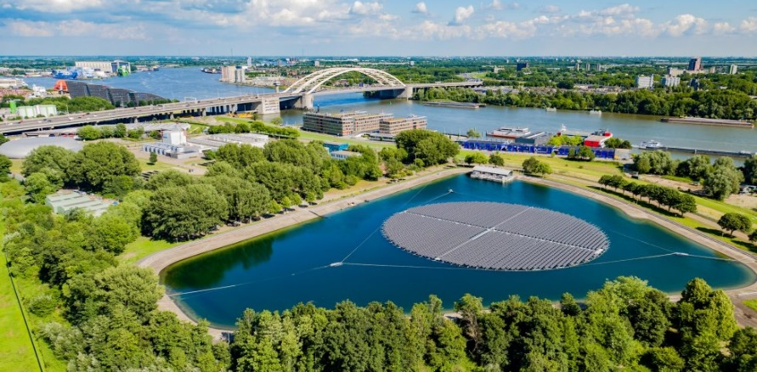
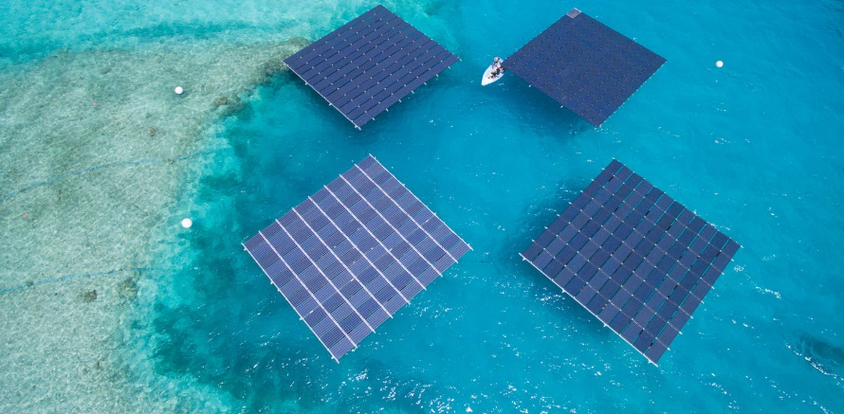
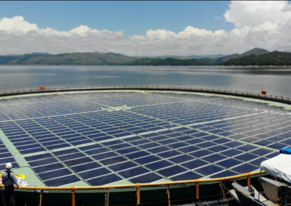
Global projects examples
Sungrow Floating
BayWa r.e.
Lightsource BP
150 MWp Guqiao– China 2019
27,4 MWp Bomhofsplas – NL 2020
6,3 MWp Heathrow – UK 2016
Floating Solar B.V.
Swimsol
Ocean Sun
1,8 MWp Rotterdam – NL 2020
0,1 MWp – Maldives 2016
0,2 MWp Magat – Philippines 2019

Slide 4
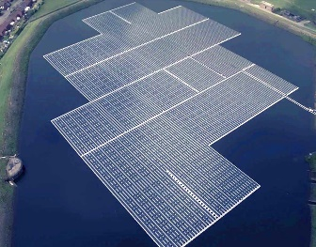
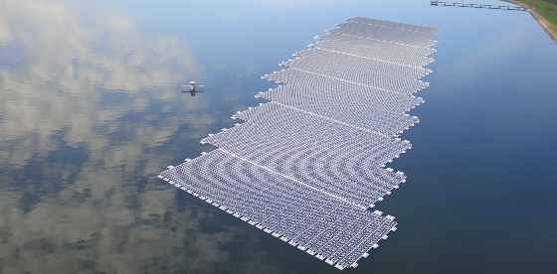
UK track record
A bright start…
Jan 2016 → Godley Reservoir – 2.9 MWp (Ciel&Terre; United Utilities)
Mar 2016 → QE II Reservoir – 6.3 MWp (Ciel&Terre; Lightsource BP)
Jan 2019 → Langthwaite Reservoir – 1 MWp (Northern Pontoons; United Utilities)
Others:
Polybell – 471 KWp
Ben Acre – 300 KWp (100 kWp *3)
Sheeplands – 200 kWp
… but little follow-up
Jan 2016
Mar 2016

Slide 5
UK Potential
240000 km² surface → 0,7% water → 1680 km² inland water bodies
100⁺ MWp/km² → 168 GWp → 10% usage → 16,8⁺ GWp theoretical potential
(based on the current PV module technology and current Floating structure technology: 500⁺ Wp modules and advancement in technology can increase this number)
How to unleash this theoretical potential?
Global good practices:
Government FIT policies (Taiwan, NL)
Government targets/investments/tenders (Asia)
Local involvement from Municipalities and Water Authorities (Netherlands RWS, Singapore PUB)
Global issues:
Lack of proper permitting and regulation framework
Lack of standardization and harmonization in FPV processes
UK:
40 GW by 2030
Southern Water issued a RfI including floating solar
Southwest Water included floating solar in their proposal for 2020-2025 WaterFuture plans
Welsh Water’s renewable energy programme includes floating solar

Slide 6
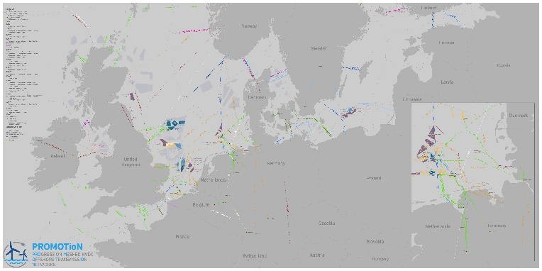
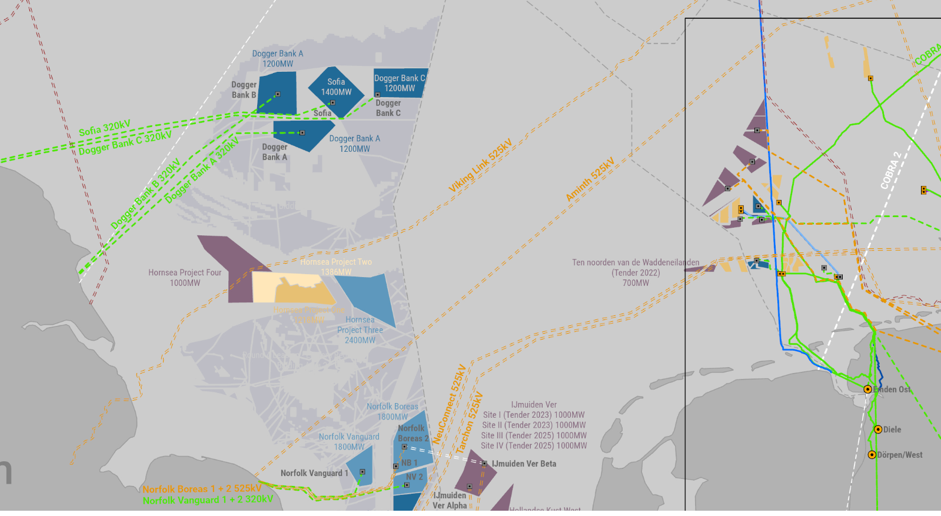
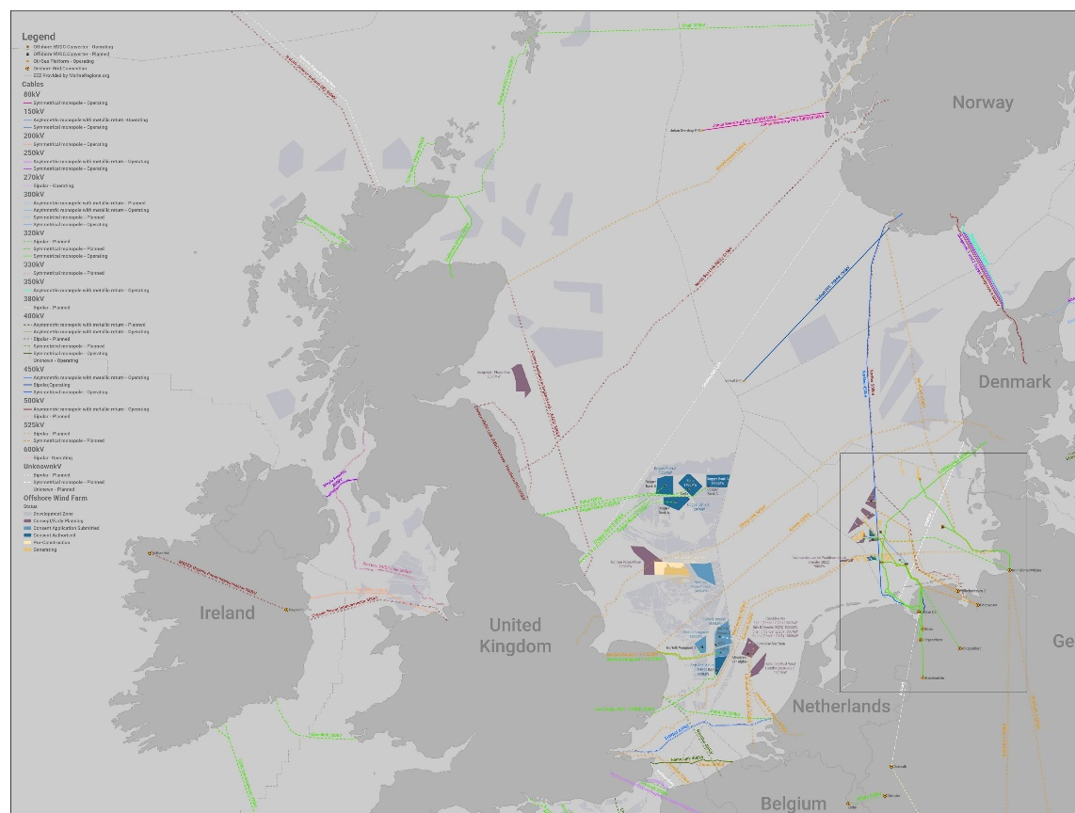
Even more UK potential
Sofia offshore wind farm 1,4 GW
A tempting thought: what would be the installed floating solar capacity in the area of an offshore wind farm?
Source: PROMOTioN project, EC H2020, images of all existing and planned HVDC links in Europe

Slide 7
Potential of offshore PV compared to offshore wind
Sofia offshore wind farm¹
Floating solar
Capacity 1400 MW
Surface 593 km²
Location 195 km off the coast of England
Water depth 20 – 35 m
Power density 2,3 MW/km²
Power density 0,023 MW/ha
Power density 1⁺ MWp/ha
Power density 100 MWp/km²
Capacity 59300 MWp = 59,3 GWp
>> factor 42… on the basis of the power capacity
>> factor 10… taking into account capacity factor and surface occupation
1) Source: www.innogy.com

Slide 8
Knowledge gaps and challenges in floating solar
Known
Partially understood
To be further explored
PV Modules
Same technology as ground-mounted and rooftop.
Floats
Lack of FPV-specific standards for quality. Challenges in durability and safety.
Mooring & Anchoring
New design challenge for solar. Experience from offshore industry.
Cabling
Experience on underwater cabling from eg. offshore wind.
Electrical layout
Various options available for positioning of components (onshore-floating).
Energy Production
Good EPA knowledge, FPV specific phenomena still to be clarified.
Operation & Maintenance
More complex (safety, cleaning schedule, access to platform, monitoring), unanticipated costs.
Materials and components
Good level of knowledge on materials for water application.
Safety
Safety issues for workers and public needs to be further examined.
Environmental impact
Little knowledge and no final research results on impact on water and on ecosystem.
Permitting
Country-specific, current regulations are difficult to apply to FPV.

Slide 9
DNV GL Floating Solar Recommended Practice
16+ relevant Floating PV stakeholders, sharing their knowledge and their experience on Floating PV projects
A DNV GL RP (Recommended Practice) is a set of requirements and guidelines for a safe, reliable and quality-driven approach in Floating Solar projects development.
The Recommended Practice will be published in Q1 2021. It will be freely available and applicable globally, without location constraints.
It will be a guideline document, to be spread and to be used as harmonized standard reference for the Floating PV industry.
Focus on inland and near-shore water bodies
It will be an holistic and comprehensive document, including:
Site conditions assessment
Energy yield assessment
Anchoring and mooring
Floating components
Installation
Health & Safety
Electrical layout
Environmental impact
Permitting
O&M

Slide 10
Floating Solar PV Recommended Practice Joint Industry Project (JIP)
CURRENT PARTICIPANTS
… and counting
BayWa r.e.
BlueC Engineering
Carpi Tech
Ciel & Terre International
CNR
DNV GL
EDF – Electricite de France
EDP – Energias de Portugal
Equinor
Isigenere
Mainstream Renewable Power
Noria Energy
Scatec Solar
Seaflex
Statkraft

Slide 11
Thank you!
Michele Tagliapietra
Saarthak Saini
Michele.Tagliapietra@dnvgl.com
Saarthak.Saini@dnvgl.com
+31 625067363
+44 (0)2038166774

