Slide 1
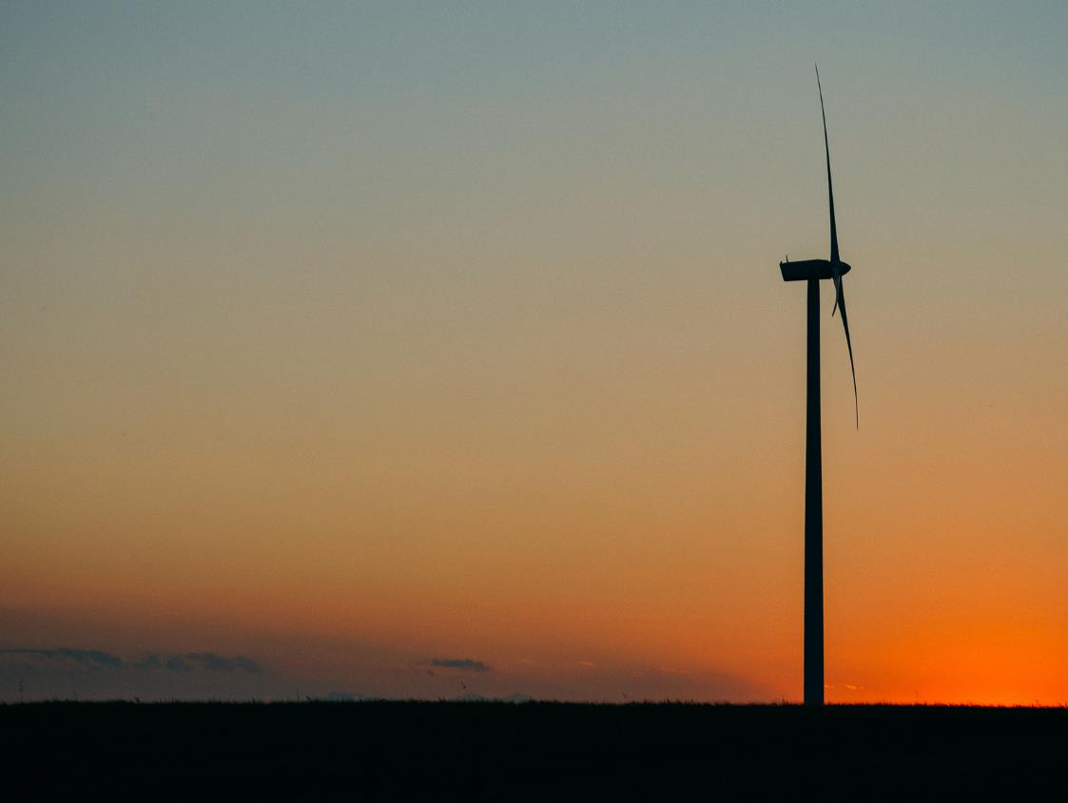
A future generation mix dominated by renewables: How will we get there?
Presenter: Angus Widdowson Head of Smart Generation Sales
20/08/2020

Slide 2
UK generation fuel mix

Slide 3
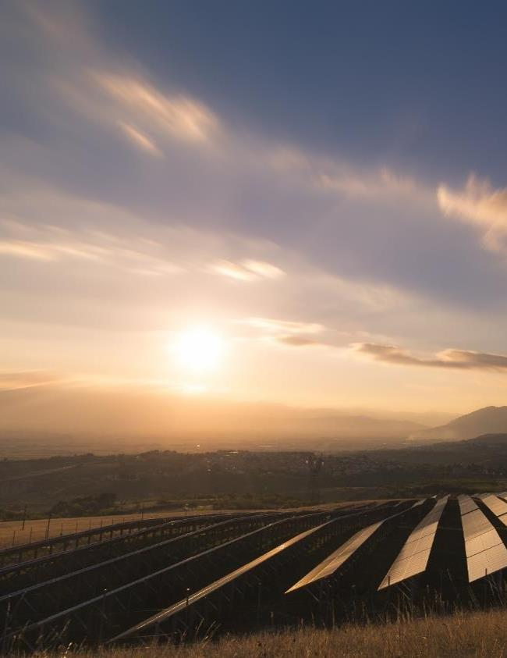
2020 record milestones
Q1 2020
Renewables take a 47% share of generation overall, which represents a new record as the highest ever share
Q2 2020
The UK goes over two months without using coal-fired generation for the first time since the Industrial Revolution

Slide 4
Future Energy Scenarios: Net-zero is achievable by 2050
40 GW
1.4 GW
3 GW
Renewable generation deployed by 2030
Solar capacity added to the grid every year until 2050
Wind capacity added to the grid every year until 2050

Slide 5
Audience poll
What’s the biggest challenge for independent generators in achieving the renewable growth targets set out in the Future Energy Scenarios Report?
Policy support
Investor confidence
Revenue certainty
Grid infrastructure

Slide 6
How do we get there? The role of the supplier
Investment and technology
Revenue streams and contract structures
Enabling
co-location

Slide 7
N.B.: This slide deck was created by SmartestEnergy for registered participants of our webinar series. Participants are asked to register to attend the individual webinar broadcasts, and resultantly receive a copy of the corresponding slides.
Communications Preferences: We take the privacy of your information seriously, and want to provide you with the option to manage your communication preferences at any time. You can opt in or unsubscribe from SmartestEnergy’s wider email marketing correspondence and view our Privacy Policy online at anytime.

