Slide 1
Hydropower Innovation
The Good the Bad and the Ugly

Slide 2
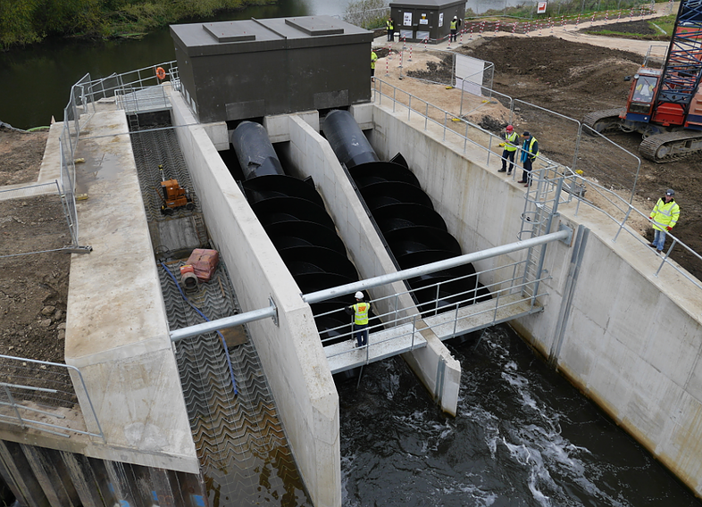
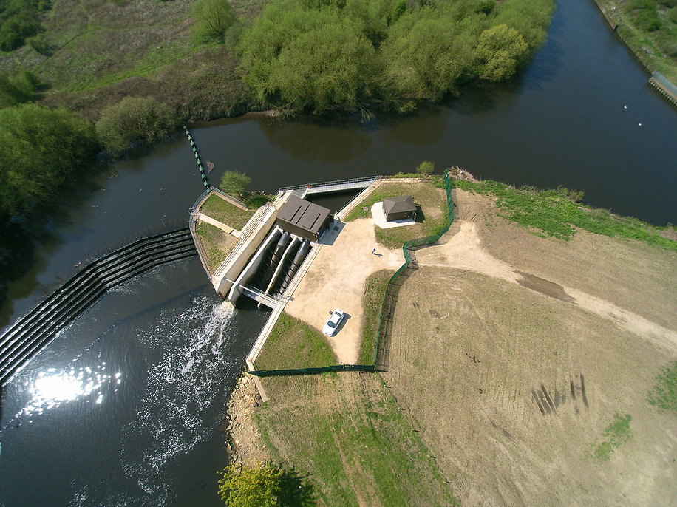
Thrybergh Weir – near Rotherham
Very Low-Head Hydropower
Drops in rivers of less than 10m
Uneconomic using conventional technologies
Half the World’s Hydro-Power potential
Notes:
It hasn’t happened because most of this hydro has small drops. Now imagine this drop, but using the full potential of the river instead of 10 to 20%, with no need for this expensive engineering, a simpler way.

Slide 3
Gabions
Inflow System
Flume
Carruthers Wheel
Notes:
Hi I’m Penny Carruthers, of Carruthers Renewables Ltd, inventor and patent holder of the Carruthers Waterwheel.
My wheel is the first hydro-turbine to work at high efficiency over the natural range of flows of a river, My Wheel is fish-friendly, easy to build, and simple to maintain and repair. All you need is a small drop in a big river, and a local mechanic for repairs, and you have stable, sustainable, renewable base-load electricity.

Slide 4
The Carruthers Wheel – 9m diameter example
https://www.icevirtuallibrary.com/doi/abs/10.1680/jcien.17.00051

Slide 5
The Good- Huge potential
Prior to 2017
Seasonal baseload = very little stress on grid nodes
Over 800 weirs in UK, profitable without FiTs
Larger number, profitable with FiTs
Even larger number of Natural cascades/waterfalls
3GWhrs for 120yrs = 2 Hinkley Point C nuclear power plants @ 60yrs
50kW to 1MW installations
Off-grid potential
Hydrogen generation
Desalination
Tidal mills – even bigger

Slide 6
The Bad – Punitive Taxation
Levelised Energy subsidies exclude business rates*
3% Solar turnover
5% Wind turnover
24% Hydropower turnover
Since 2017 business rate revaluation
Profitable English projects bankrupt
Reliefs granted in Scotland and Wales
Financing no-longer available
Most ongoing projects paused awaiting Appeal Court decisions
Rich Scottish and Welsh landowners only
* https://www.gov.scot/publications/report-small-scale-hydro-plant-machinery-review/

Slide 7
The Ugly
Simplest solution – de-rate hydropower
UK primary legislation
Government do not view hydropower as innovative
Excluded from Energy Catapult help and resources
Too small a market to justify the effort

Slide 8
Köppen-Geiger climate classification
The areas suitable for the Carruthers VLH System are,
Thermal Climate Zones
Excellent – Blue Zones, high rainfall either seasonal or monsoon
Very Good – Green Zones, moderate rainfall mostly seasonal
Arid Climate Zones
Do-able – Yellow and Purple Zones,
Not viable – Red, Orange and Grey Zones, excepting areas with rivers flowing through them, e.g. Nile and its tributaries

Slide 9
Carruthers Renewables Ltd
Penelope Carruthers MSc
penelope@carruthersrenewables.co.uk
www.carruthersrenewables.co.uk

