Slide 1
A future generation mix dominated by renewables:
How will we get there?
Robert Hokin
Managing Partner
robert.hokin@greenbackers.com

Slide 2
Greenbackers:
Specialists in climate, cleantech & circular economy capital

Slide 3
Managed fundraises &
private placement campaigns
(Series A – C)
Investment Pitch (10 -> 200)
(Seed & Series A)
Entrepreneur coaching
for investment readiness
Our Mission
Mobilising capital for climate business growth

Slide 4
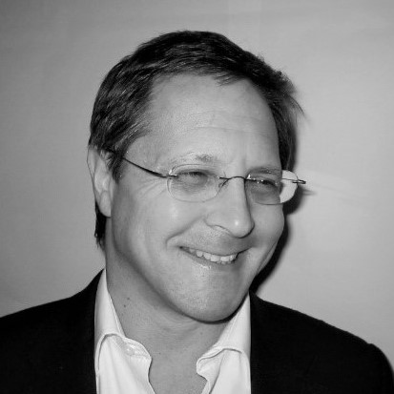
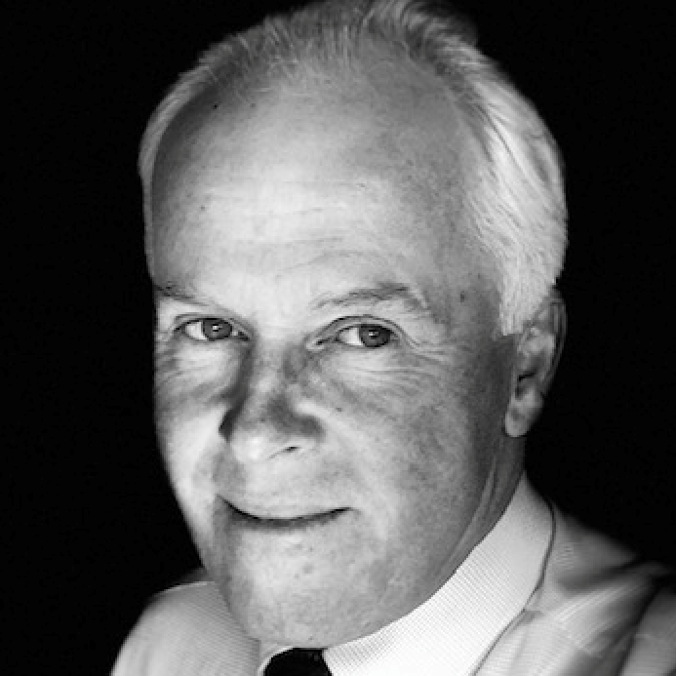
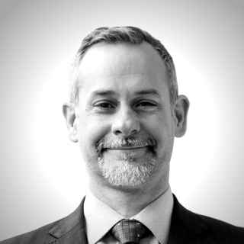
Our Team
John Steedman
Andrew Smith
Partner
Prev. BP Ventures
Partner
Prev. Scottish Investment Bank
Robert Hokin
Tony Gale
Founder & Managing Partner
Prev. ABB, Worldcom, GEC Marconi
Senior Associate
Prev. General Electric
Jim Wilson
Jae Mather
Associate
Prev. SSE Ventures
Associate
Prev. Clean Energy Association, Canada

Slide 5
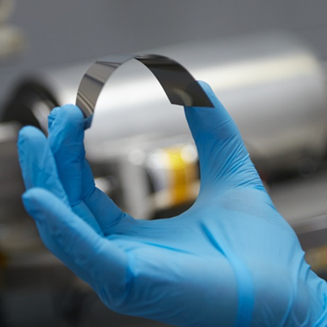
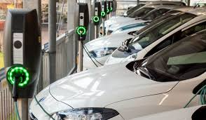
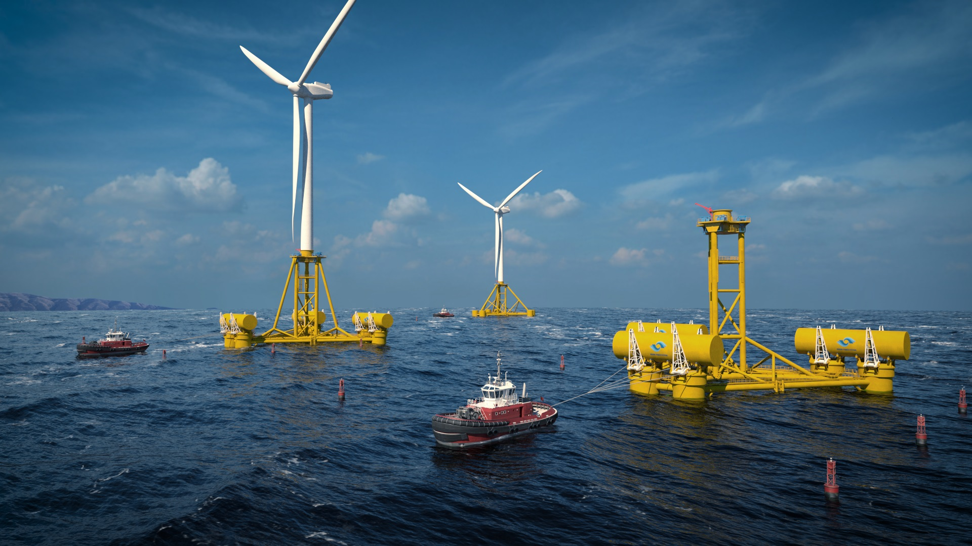
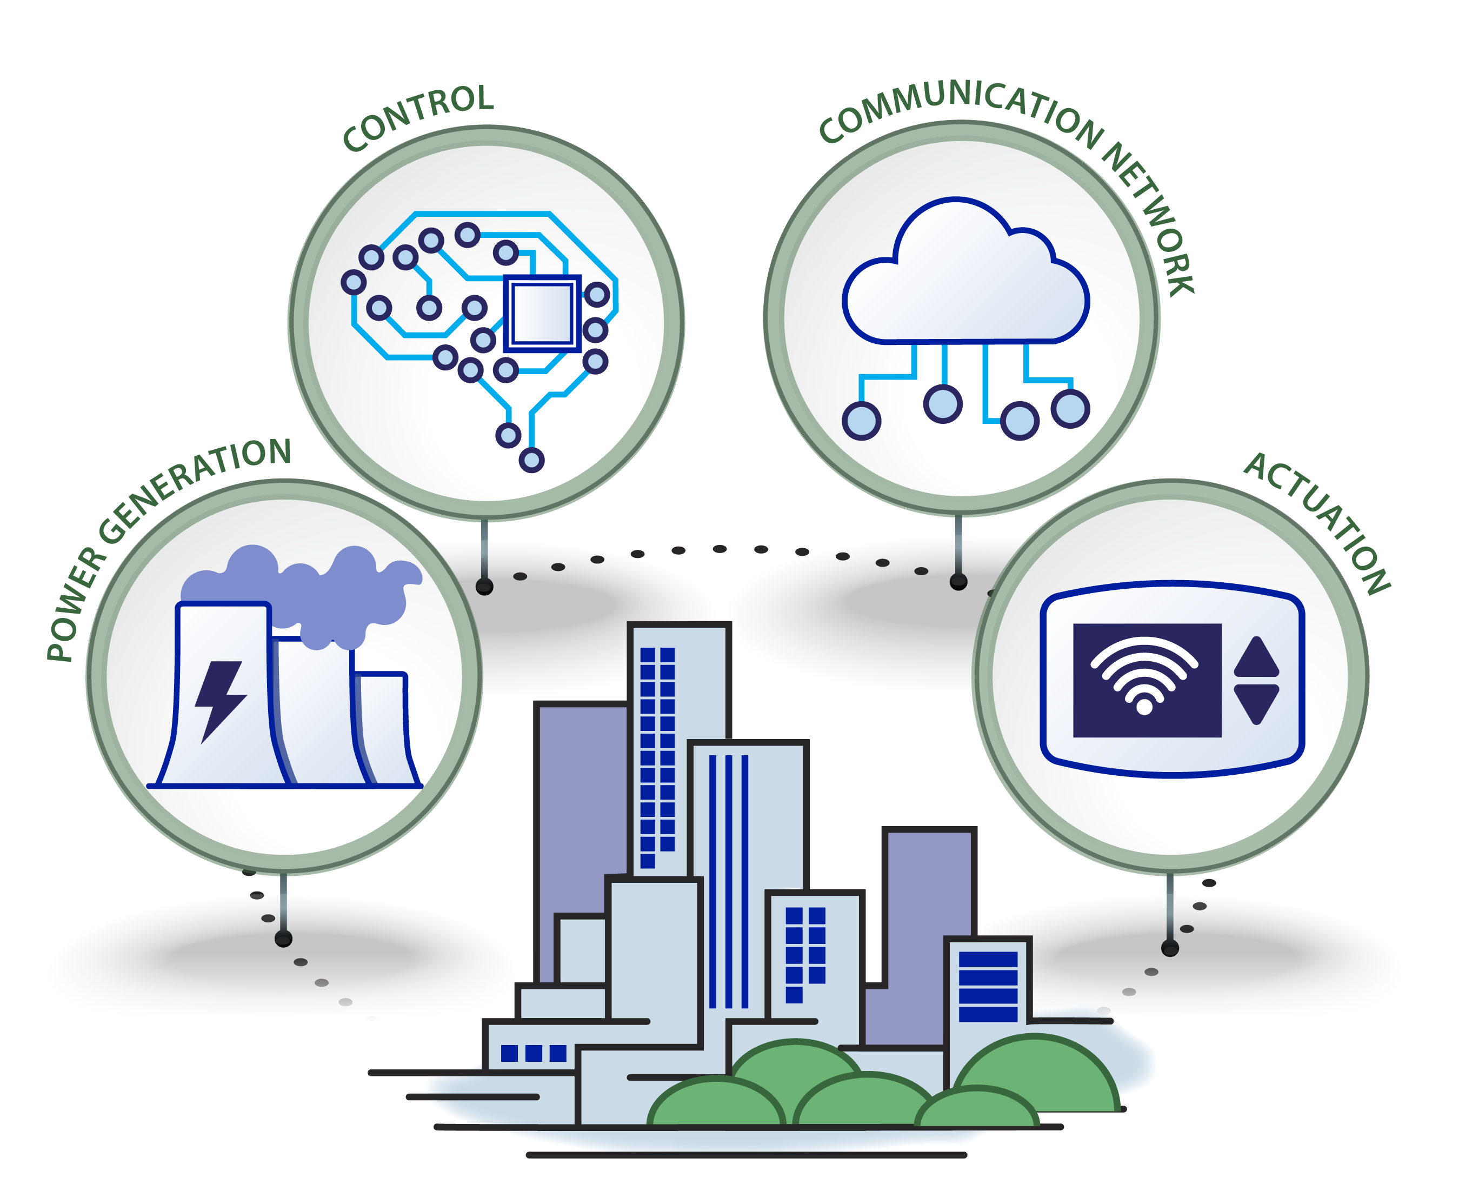
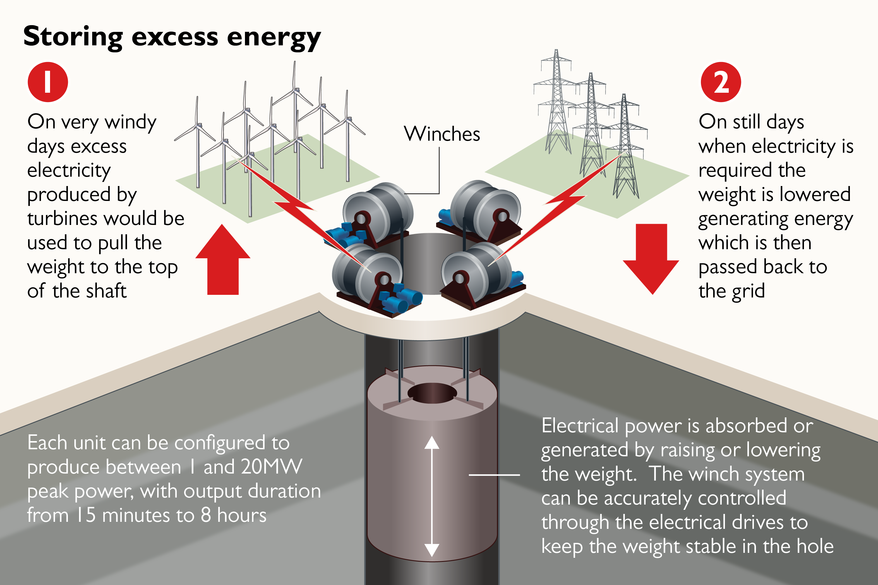
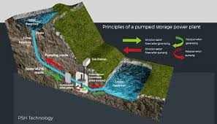
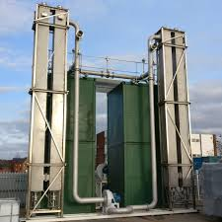
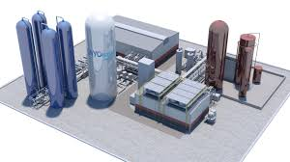
A future generation mix dominated by renewables:
How will we get there?
Solar power with using micro-structures smaller than a human hair
Vehicle to Grid
Hybrid Wind & Wave
Innovation?
Grid Balancing
Gravity Storage
Energy Efficiency
Pumped Storage Hydro
Thermal and compressed air
Cryogenic Air Storage
Pedot-coated bricks

Slide 6
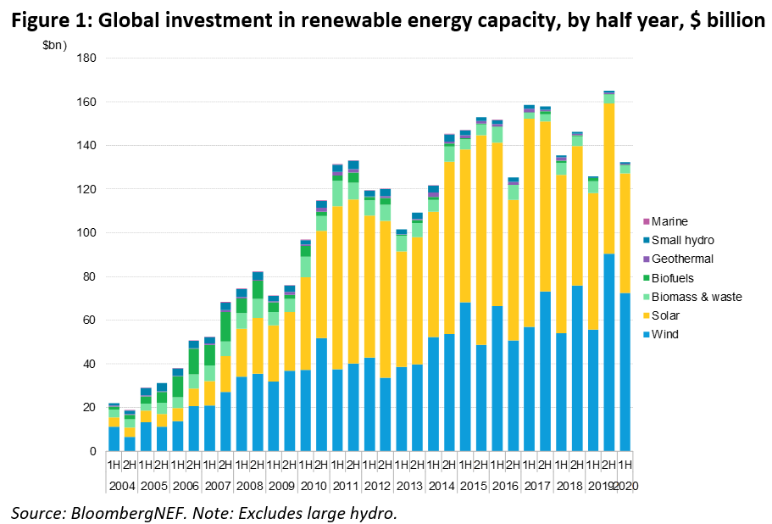
A future generation mix dominated by renewables:
How will we get there?
Investment?
Dwarfed by UK Public spending on Covid: “…set to rocket past £1 trillion for the first time this year as ministers pour taxpayer money into tackling the health and economic crises sparked by Covid-19.” Source: The Telegraph June 2020

Slide 7
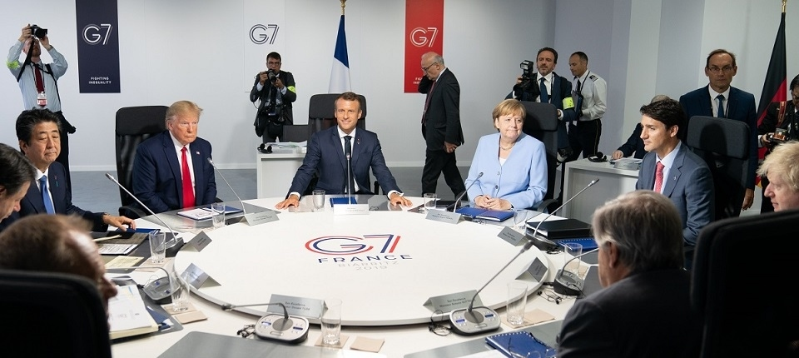
A future generation mix dominated by renewables:
How will we get there?
Set a Carbon price and make it stick?
Prioritise skills training in renewables and related industries. Put people to work?
Greater incentives to unlock investment. Tax climate damaging behaviours?
Policy?
Stop back door subsidies to fossil fuel interests? “Over the last seven years, the UK has spent 60% of its overseas support for energy investment in developing countries on fossil fuels, with more than £4.6bn spent.” Source: Edie.net
How old (if still alive) will the current G7 leaders be in 2050?

Slide 8
A future generation mix dominated by renewables:
Will we get there?
We can have as many meetings as we like, but unless the will for significant change is there, Net Zero will be a challenge to achieve in most of our lifetimes, if at all.
Society must start really treating this as a crisis – think positive, think smart, think shorter timelines, think like our lives depend on it.

Slide 9
A future generation mix dominated by renewables:
How will we get there?
Thank you!
Robert Hokin
Managing Partner
robert.hokin@greenbackers.com

