Slide 1
All-Energy: A future generation mix dominated by renewables
Stuart Lunn
August 2020

Slide 2
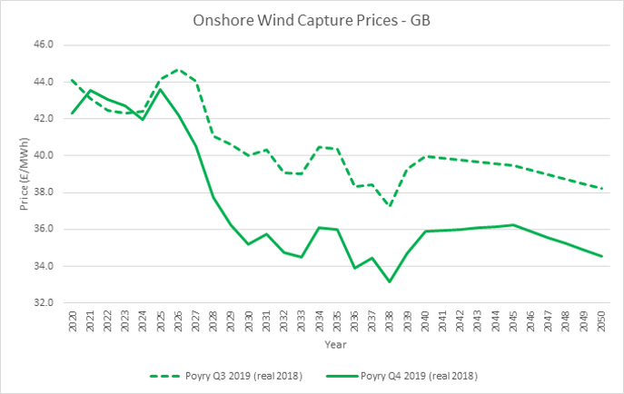
Ambitious and Positive Targets
Onshore wind capacity needs to expand by at least 1GW a year to achieve our net zero emissions target, reaching 35GW by 2035. This would require approximately 29GW to be installed by 2030
Committee on Climate Change
Our world-leading offshore wind industry will reach 40GW by 2030
UK Government
“Zero marginal cost generation will provide up to 71% of generation output in 2030, and up to 80% in 2050”
National Grid – Future Energy Scenarios

Slide 3
Policies for a Net Zero World
CFDs
Great to see onshore projects eligible again
Need clarity on budgets, delivery years and eligibility of onshore beyond AR4
Carbon Price
Investors are looking for a clear long term price trajectory
Zero Carbon Commission calling for £80/tonne by 2030
Demand and Flexibility
Green Hydrogen from wind and solar
Electric vehicle charging
Clear investment signals for flexible low carbon generation
Onshore Targets
CCC Calling for 35 GW of onshore wind by 2035
Investors want clarity on pipeline of investment opportunities
Our energy markets will need to evolve to meet the net zero challenge;
but generators must also evolve and adapt to this new world…

Slide 4
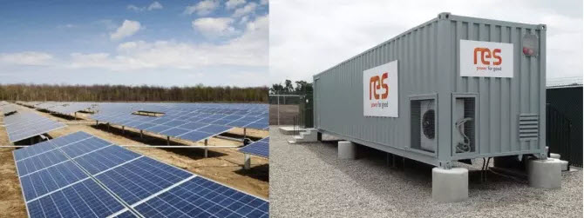
Operating Strategies for a Net Zero World
The transition to net zero will require new operating strategies for renewable generators...
Dispatching Renewables
Solar plus Storage
Balancing Mechanism
ODFM
Power Available
Life Extension
“RES breaks ground on dispatchable PV project that shows a flexible path for San Antonio”
Energy Storage News

