Slide 1
Greening the Blue Economy:
Marine Energy
14th October 2020

Slide 2
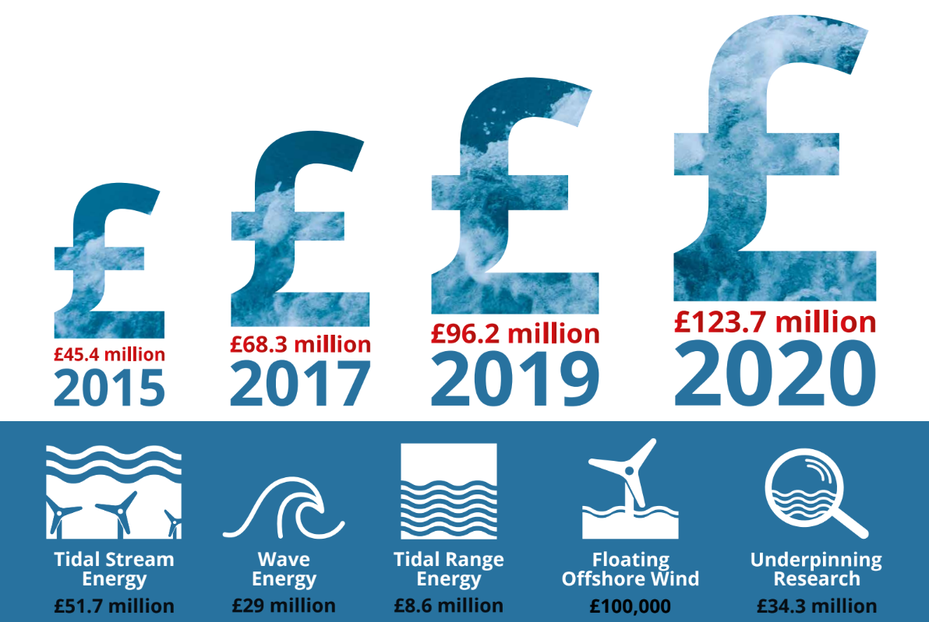
Marine energy wales:
State of the sector report - 2020
16 marine developers active in Wales
4 test sites
Seabed agreements for 532 MW
£123.7m invested in Wales between 2015 and 2020
The sector has provided 737 person years of employment to date

Slide 3
Recent strategic investments
The past 12 months has seen strategic innovation and infrastructure investments announced including:
Pembroke Dock Marine’s £60m investment across innovation, port infrastructure and test and demonstration facilities
€4.6m Tiger Regeneration Project at Ramsey Sound will provide an integrated tidal stream test facilities to the industry

Slide 4
Wales – supply chain expertise
 | Component / Service
Development Costs | Consultancy services, engineering services, environmental monitoring, other development spend, project development, project management. Substructure design & Fabrication: assembly yard, manufacture, secondary steel and substructure fabrication
Electrical Infrastructure & Cables | Onshore electrical contractors, offshore cable manufacture
Ports, Logistics, Operations & Maintenance | Existing key port infrastructure Port of Milford Haven, Port of Mostyn, Port Talbot, Holyhead
Vessels & Sub Sea Engineering | Vessel operators
Test facilities | Swansea University – tank testing service Marine Energy Test Area in Pembroke Dock Marine Energy Engineering Centre of Excellence (MEECE) Wave Hub Limited – Wave demonstration zone Morlais – tidal stream demonstration zone

Slide 5
Wales – marine sector next steps
Clear UK Government policy direction PLUS dedicated Revenue / IPPA support via existing or new mechanisms
Growth of local supply chain capability alongside sector to enable regional economic growth in coastal communities
FDI requirement to ‘fill the gaps’

Slide 6
Helen donovan
Senior industrial transformation manager
Helen.donovan@gov.wales

