Slide 1
PPAs from a Nordic perspective
Svanhild Vesterheim, managing associate
All-Energy webinar, 30 September 2020

Slide 2
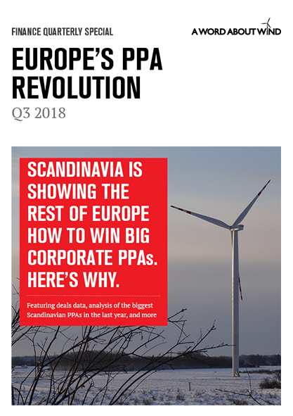
Nordic corporate PPA drivers
The Nordic region has dominated the corporate PPA market in Europe over the past years
Norwegian-Swedish renewable support system (the el-certificate scheme)
High quality wind resources and vast hydropower resources
Project financing – securing bankability
Demand from large industry companies and technology giants
Low power prices
Snowball effect

Slide 3
PPA – commercial factors
Electricity costs
Revenue certainty
Business / leadership - sustainability
Timing certainty
Project bankability

Slide 4
Wind PPAs adds complexity – general project structure
Share Purchase Agreement
Key agreements
Former Owner/
Developer
Asset Manager
Construction Management Agreement
Fund/
Investor
HoldCo
BoP agreements
Subordinated bonds/other equity instruments
Service and Availability Agreement
HoldCo
(NOR)
Credit Facility Agreement
Turbine Supplier
Lenders / Security Agent
Project Company
O&M agreement
El Certs
GoOs
Electricity
Fixed Price
Grid Connection Agreement
Direct Agreement
DSO
Shareholder Group
PPA Off-taker
Wind Farm/SPV Group
Trading License
Norwegian Water Resources and Energy Directorate
Market Price
Physical Power Purchaser
Imbalance Agreements
Electricity
TSO
Balance Responsible Party
eSett
Balance Responsible
Other Major Parties
Electricity
Market Price
Market or bilateral agreements

Slide 5
Contract Structure
Anticipated Completion Date
Commercial Operation Date
Purchase of GoOs or other environmental elements
Purchase of El-certificates
Signing Date
Market Price
Purchase of electricity: Fixed price
2019
20XX
20XX
20XX
Term: XX years
20XX
Financial Close
End of Term
PPA Direct Agreement
Lack of Capacity
Pass Through of Yield Damages
Curtailment
Non-Production Event
Events of Default
Force Majeure
No Financial Close
If negative spot price
If special regulation (TSO)
No fault Termination
Compensation?
Compensation by Seller
Reimbursement by Purchaser
Remuneration or cost back-to-back
Compensation by Seller
Change In Law
Key dates
(Early) Termination
Key obligations/rights
Compensation clauses
Termination Payment
Exit provisions

Slide 6
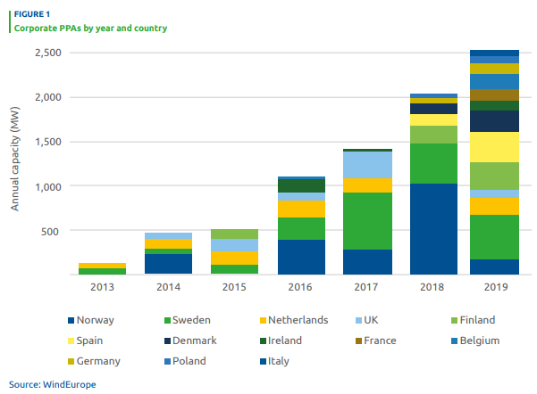
PPA – overview 2019
Will the Nordic region continue to be Europe’s PPA forerunner?
2019 figures shows a decrease
Europe had a promising start to 2020, with PPAs totaling 1.4 GW signed per July.
The Nordics, which typically dominate, saw just 400 MW of PPAs announced in the first seven months.
Key factors and future outlook for Norway going forward
Source: Wind Europe

Slide 7
Potential developments
Will the PPA format change?
Shorter duration?
Bundling of wind/solar and/or hydropower
24/7 PPA?
Commoditization of renewable energy procurement
Education off-takers / customers
Development of blueprint corporate PPA products (EFET)
Lenders; higher acceptance of the merchant risk?
Will the buyer types change?
Multiple off-takers?
The “Dutch wind consortium” (potentially replicable model)
Institutional investors such as pension funds
New types of energy intensive industries
Insurance products?

