Slide 1
All Energy webinar
The Climate Emergency and Planning: have we got the balance right? A developers Perspective
4 November 2020

Slide 2
Onshore wind policy and The path to net zero
Are we acting with “appropriate urgency”?
On the one hand…
On the other hand…
Policy hiatus
Nov 2016 - The Paris Agreement
2017 - The Scottish Energy Strategy (SES)
May 2019 – CCC published report Reaching Net Zero
April 2019 – Climate Emergency declared by Scottish Government
Oct 2019 - Climate Change (Emissions Reduction Targets) (Scotland) Act 2019 making net zero targets legally binding
March 2020 – onshore wind to be eligible to compete in the next Contracts for Difference round (due 2021)
Planning system reliant on NPF3 and SPP which are outdated
Scottish Government consultation on SPP and Housing
Emerging LDP’s that don’t prioritise the climate emergency
Ongoing reference to out of date Landscape Capacity Studies
Feedback that the declared climate emergency has made no difference so far to the way applications assessed…
….more and more sites refused and delayed at PLI…
2020 was to have been the year that NPF4 emerged to bridge the gap and provide the strategic direction needed.
The delays are perhaps understandable and inevitable.
However, there is no getting away from the fact the planning system has not caught up with the requirements of the climate emergency.
Expected Autumn statement is an opportunity…

Slide 3
The targets
The UK has to reach net zero emissions targets by 2050 and Scotland by 2045.
There is a requirement to quadruple renewable energy by 2050 to meet the targets.
For onshore that means we need 35GW by 2035.
In relation to Scotland that means up to 24GW by 2035. We have 8GW now.
That means building out over 1GW a year for the next 14 years.

Slide 4
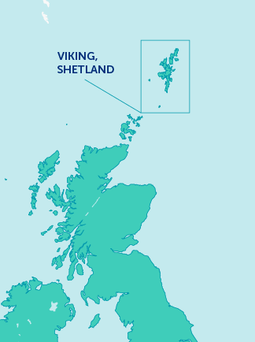
delivering onshore wind
Viking, Gordonbush Extension and Tangy
VIKING WIND FARM EXPECTED TIMELINE
443MW project with estimated load factor of 48%
Largest onshore wind farm in the UK in output terms
First export expected Q2 2024
NEW MAPS IN DEVELOPMENT.
TO BE SUPPLIED BY CALLUM TOSH. 15/06/20
GORDONBUSH EXTENSION
Gordonbush Extension
11 turbine development with an installed capacity of 47MW
Extension to the existing 70MW Gordonbush windfarm
First export expected Q1 2021
Gordonbush Extension
GORDONBUSH EXTENSION
TANGY REPOWERING
Tangy Repowering
Existing 22 turbine site with installed capacity of 18.7MW (75m to tip height)
Consented project of 16 turbines with estimated installed capacity of 80 MW (149.9m to tip height)

Slide 5
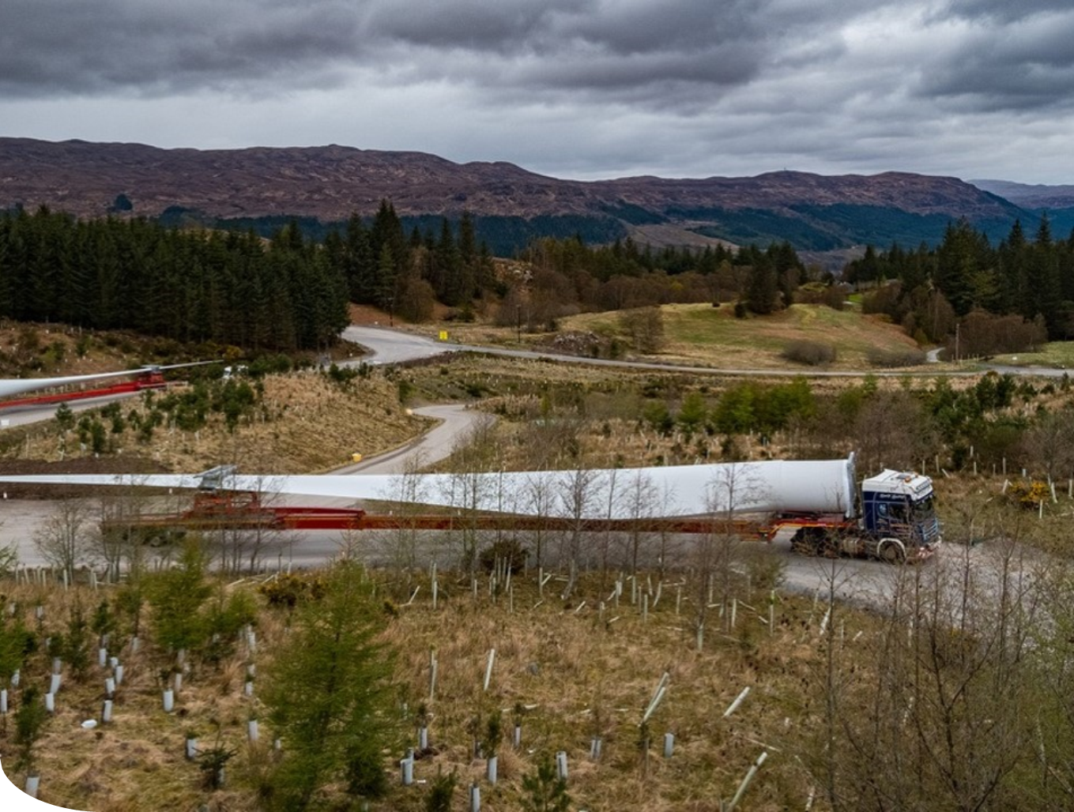
Onshore wind constraints
No such thing as an easy site
Windy sites are more critical than ever.
Hard constraints like land, access, grid not getting easier with larger turbines.
The focus on local landscape impacts hinders progress towards the targets.
There is not always a technical solution.
Whether the project is competing in a CfD auction or being developed out on a fully merchant basis, it doesn’t change the way we develop projects.

Slide 6
Getting the balance right
Removing the Roadblocks, Prioritising and Balance
We can’t have ‘business as usual’.
Local landscape impacts are currently tilting the balance in the wrong direction.
Vital that delivering net zero carbon is at the heart of Scotland’s planning system and NPF4 is central to achieving this.
Spatial Frameworks – which do not dictate size of turbines or cap on development
Repowering and Life Extension – presumption in favour.
Wild land mapping and policy should be reviewed in light of the Climate Emergency.

Slide 7
Thank you

