Slide 1
The Green Recovery
All-Energy and Dcarbonise
Angus McCrone

Slide 2
The data in 2020

Slide 3
Global investment in renewable energy capacity
Source: BloombergNEF

Slide 4
Global investment in offshore wind capacity
Source: BloombergNEF

Slide 5
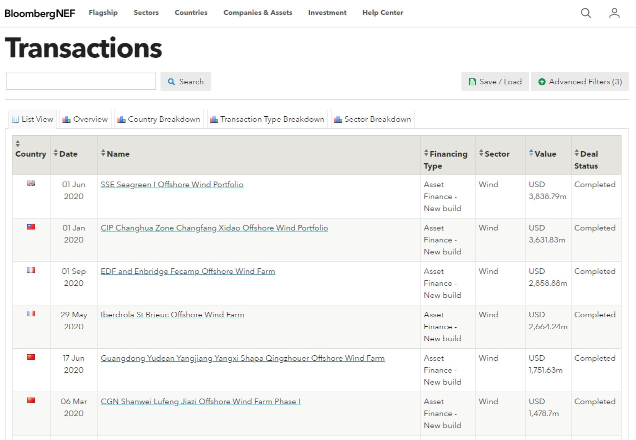
2020 deals in offshore wind
Source: BloombergNEF

Slide 6
U.K. investment in renewable energy capacity
Note: 2020 figure is for first half of the year only
Source: BloombergNEF

Slide 7
Clean energy shares v oil company shares in the last year
Source: BloombergNEF
Note: WilderHill New Energy Global Innovation Index, or NEX, versus NYSE Arca Oil Index, both rebased to 100 on September 18, 2019

Slide 8
Clean energy ETFs quadruple in value in one year
Note: Puts together nine clean energy exchange-traded funds
Source: BloombergNEF

Slide 9
Money raised by quoted EV companies on stock markets
Note: ‘Announced’ issues are PIPE transactions between privately owned companies and special acquisition companies, or SPACs
Source: BloombergNEF

Slide 10
Policy in 2020

Slide 11
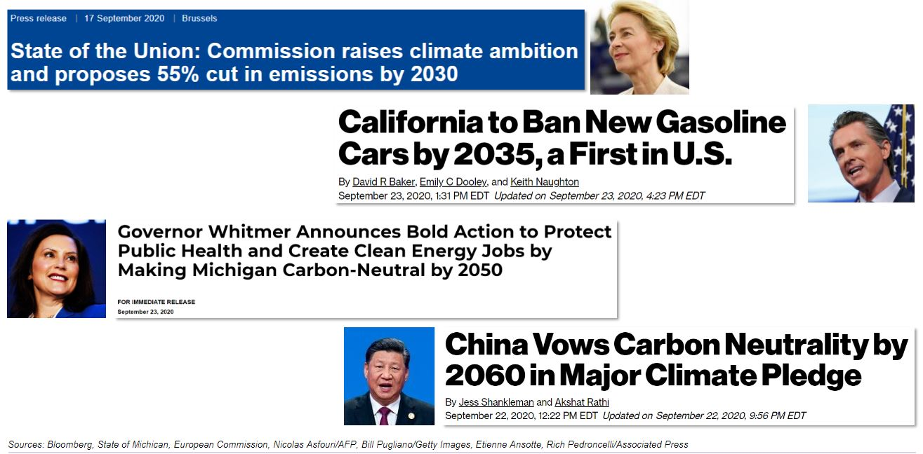
Covid era policy changes

Slide 12
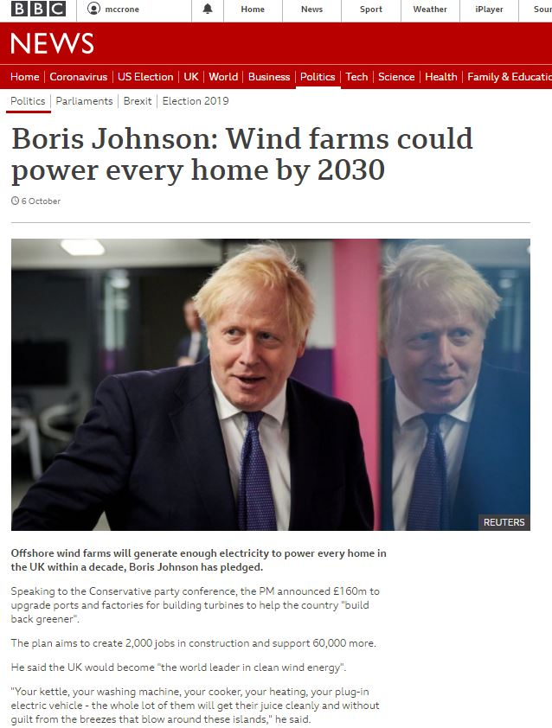
Covid era policy changes
Source: BBC

Slide 13
EU emission trajectory and targets
Source: European Environment Agency, European Commission, BloombergNEF.

Slide 14
Stimulus approved and near completion as of September 30, 2020
Source: Governments, media reports, BloombergNEF. Note: ‘Approved green stimulus’ includes support to CO2-intensive sectors and companies with green conditions. Figure does not include the remaining 70% of the latest version of the EU package because it is not yet known how much will be targeted specifically at carbon-intensive sectors and companies.

Slide 15
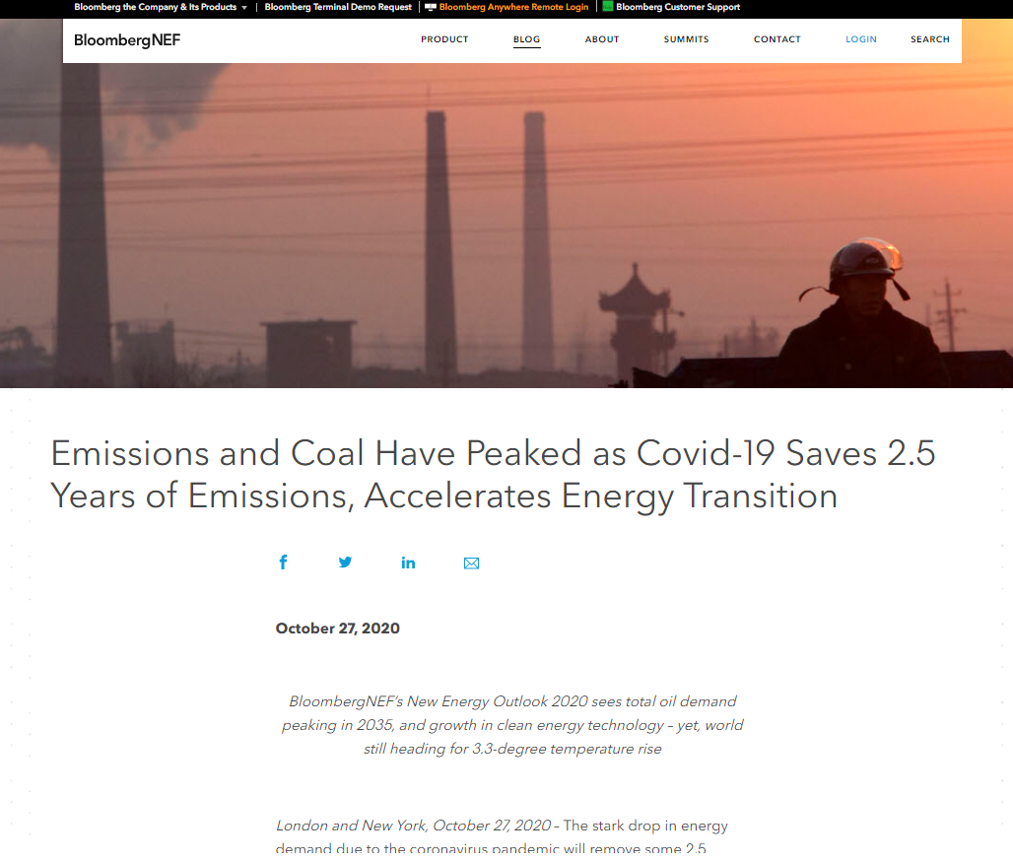
Long term
Source: BloombergNEF

Slide 16
Copyright and disclaimer

