Slide 1
Low Carbon Infrastructure
Transition Programme
Carole Stewart

Slide 2





LCITP

Slide 3
Overview
Accelerate delivery of low carbon energy opportunities across Scotland;
Support ambitions set out in Scotland’s Climate Change Plan;
Project Development Support and Capital Investment;
28 Demonstrator Projects across Scotland.

Slide 4
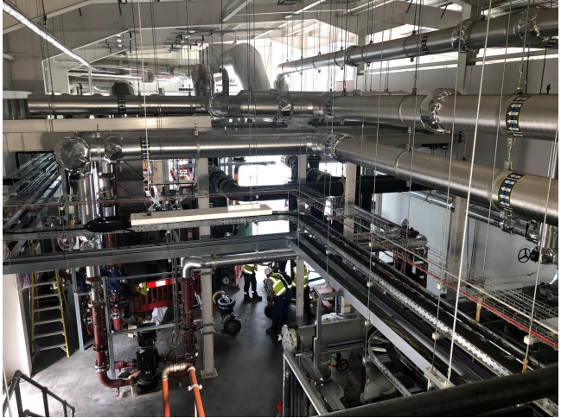
Heat Networks

Slide 5
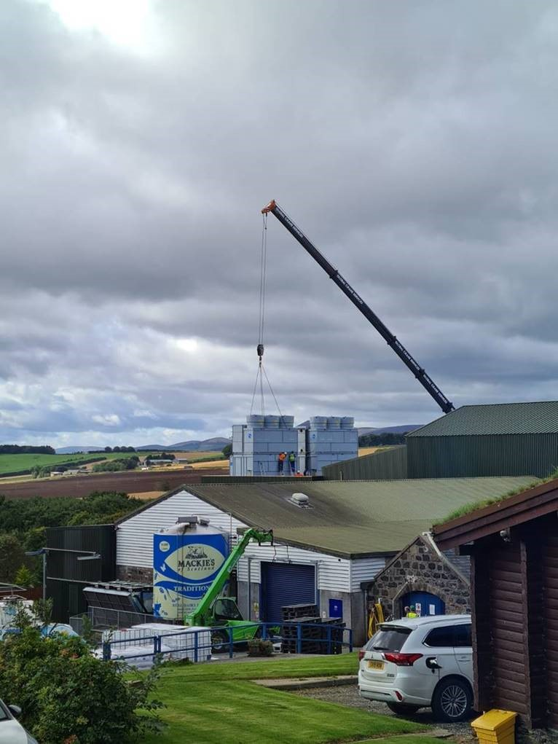
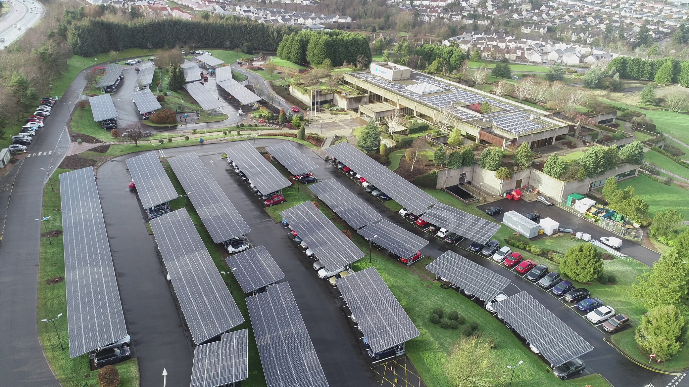
Green Business

Slide 6

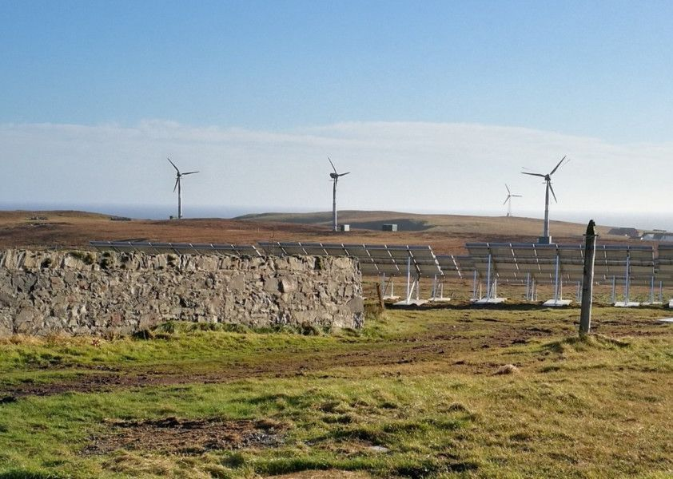
Energy Systems

Slide 7
Lessons Learned and Future
Dissemination of Learning and Monitoring
Demonstration to Deployment
Current Opportunities:
  £50 million LCITP Green Recovery Capital Fund
  £20 million Social Housing Net Zero Heat Fund

Slide 8
Thank You
Contact us at lcitp@gov.scot
http://www.gov.scot/lowcarbon

