Slide 1
Hydrogen Taskforce

Slide 2
Who is the Hydrogen Taskforce?
The Hydrogen Taskforce brings together the organizations leading on hydrogen across the value chain to make the high level energy system, economic and environmental case for hydrogen in the UK.

Slide 3
Key questions for 2020
What is the role of hydrogen in the UK?
What do we need to do now to achieve that?

Slide 4
Key questions for 2020
How much hydrogen?
Where should it be used?
What is the role of hydrogen in the UK?
How much carbon could we save?
What do we need to do now to achieve that?
What economic benefit would this unlock?
What are the energy system implications?
What existing assets can we leverage?
Where can the UK take a global leadership position?

Slide 5
Key questions for 2020
What are the barriers?
How much hydrogen?
Where should it be used?
How do we ensure consumers are engaged?
How do we reduce costs?
What is the role of hydrogen in the UK?
How much carbon could we save?
What do we need to do now to achieve that?
What economic benefit would this unlock?
What is the role of Government?
What are the energy system implications?
How do we encourage coordination across sectors?
What existing assets can we leverage?
Where can the UK take a global leadership position?
What infrastructure will we need?
How do we ensure we have the right skills?

Slide 6
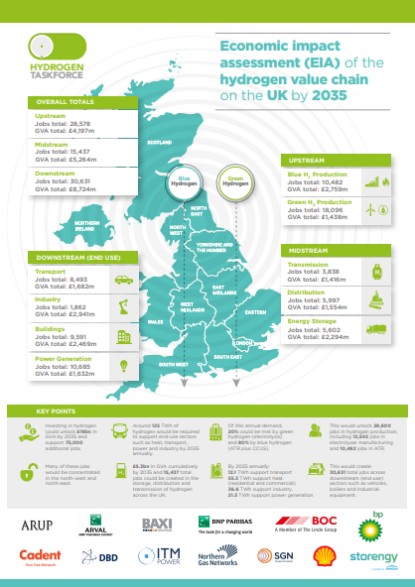
Making the case – Economic Impact Assessment
Economic value and job creation estimated across the entire hydrogen value chain by 2035:
Upstream
Production – blue and green
Midstream
Transmission & distribution
Energy storage
Downstream
Power generation
Transport
Heat in Buildings and Industry

Slide 7
Results and findings: GVA and jobs
Unlock ~£18bn in GVA by 2035
Create ~75,000 gross jobs by 2035

Slide 8
What needs to happen now?
Develop hydrogen storage pilots
Deploy 100 HRS by 2025
CfD for green hydrogen
Support industrial hydrogen clusters
Amend the GSMR to allow hydrogen blending
Live hydrogen heating trial
Business model for blue hydrogen with CCUS

Slide 9
The UK hydrogen strategy…

