Slide 1
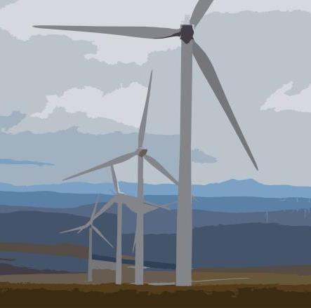
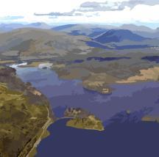
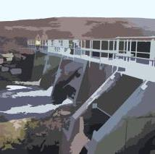
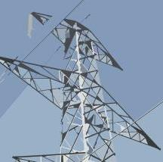
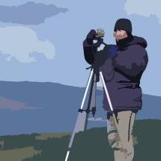
The Climate Emergency & Planning: Have we got the balance right? A Landscape and Visual Perspective. 04.11.20
Jennifer Skrynka- Managing Director (jskrynka@ashglasgow.com)

Slide 2
Areas covered
LVIA practices – An overview;
Opportunities for future development ;
Taller turbines in the Scottish landscape - Examples;
Main hurdles from an LVIA perspective;
Proportionality - and changes in the Scottish Landscape.

Slide 3
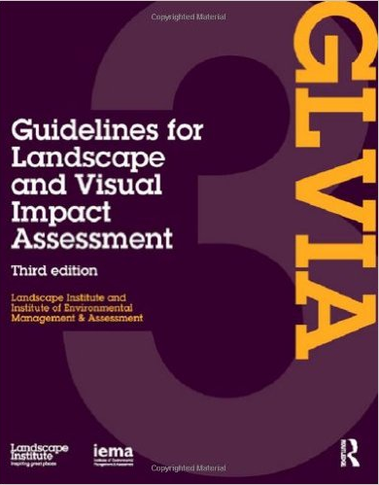
1. GLVIA Methodology
LVIA is “a tool used to identify and assess significance of effects of change resulting from developments in both the landscape as an environmental resource and on peoples’ views and visual amenity.”
Landscape Character Assessment and Assessment of Visual Amenity are two separate, though related processes.
LVIA considers Sensitivity of Landscape / Visual Receptors to development, and Magnitude of Change.
Significant Effects (generally Moderate & above).
LVIA identifies how widespread are Significant Effects, considering overall Landscape & Visual Resource of Study Area? LVIA does not provide an opinion on acceptability (Planning Statement)

Slide 4
2. Future opportunities for onshore wind
Extensions
Repowering
New sites

Slide 5
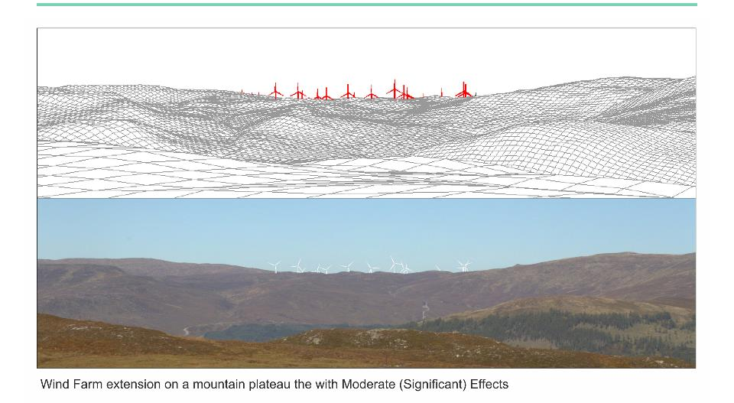
3a. Example of taller turbines in the landscape.

Slide 6
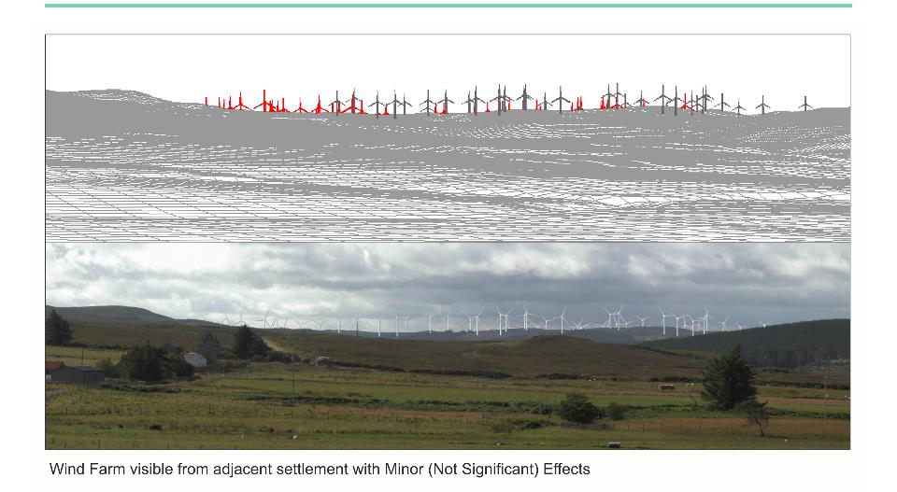
3b.Example of taller turbines in the landscape.

Slide 7
4. Main Hurdles
(4a)Escalating Methodology & Guidance;
(4b)Wild Land Areas (WLAs);
(4c) Visualisation Requirements; and
(4d) Lighting Assessment Requirements.

Slide 8
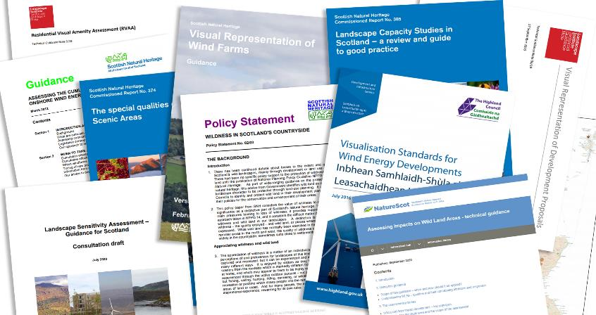
4a. Guidance and Methodology Documents

Slide 9
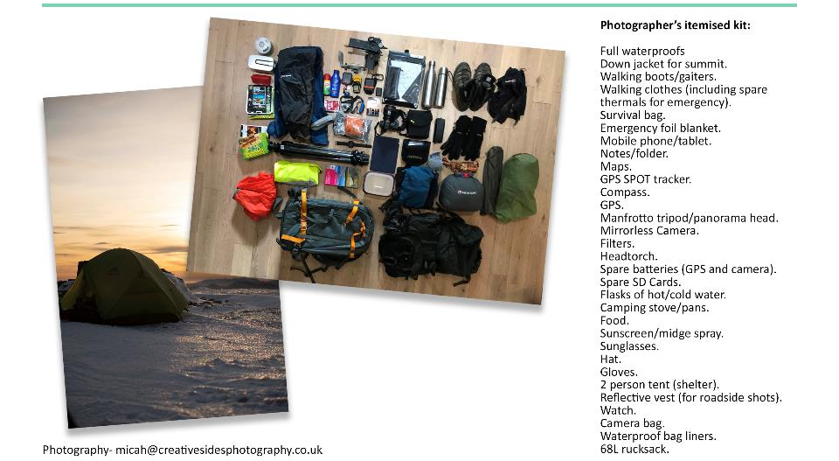
4c. Viewpoint Photography

Slide 10
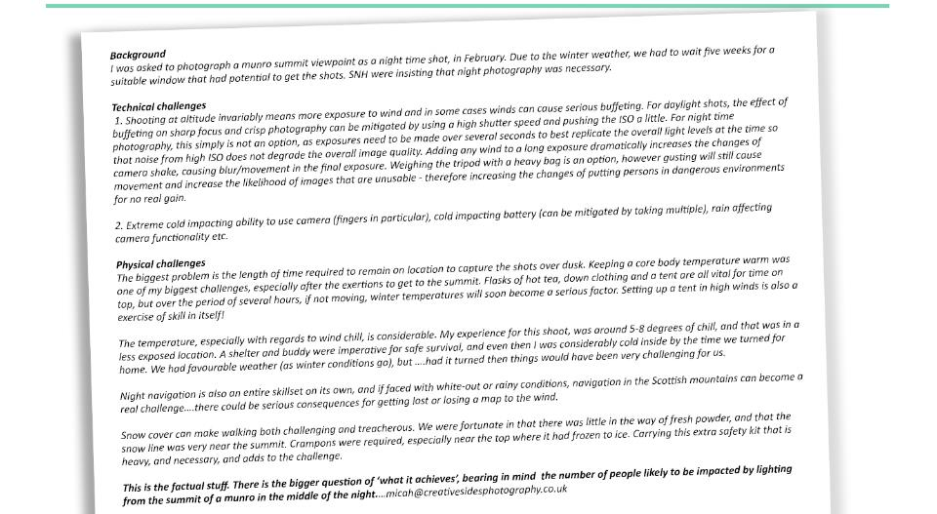
4d. Letter from a freelance photographer

Slide 11
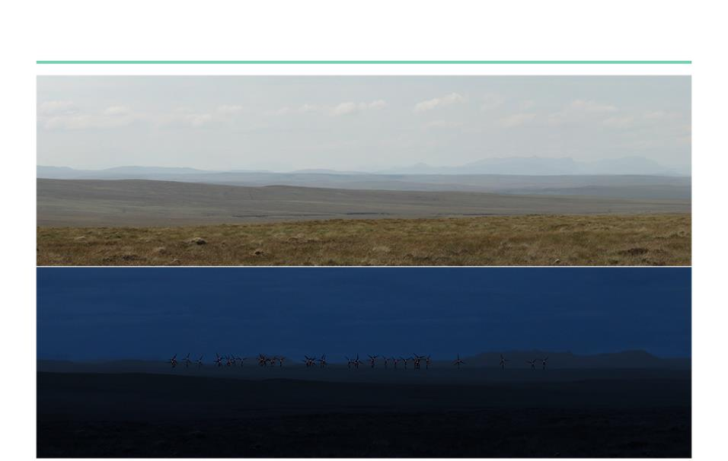
5a. Proportionality - Manipulated photograph

Slide 12
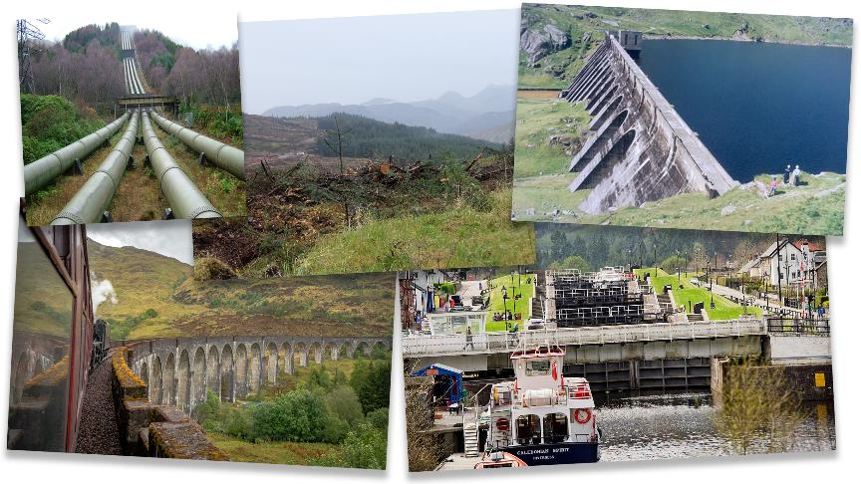
5b.Changes in the Scottish Landscape

Slide 13
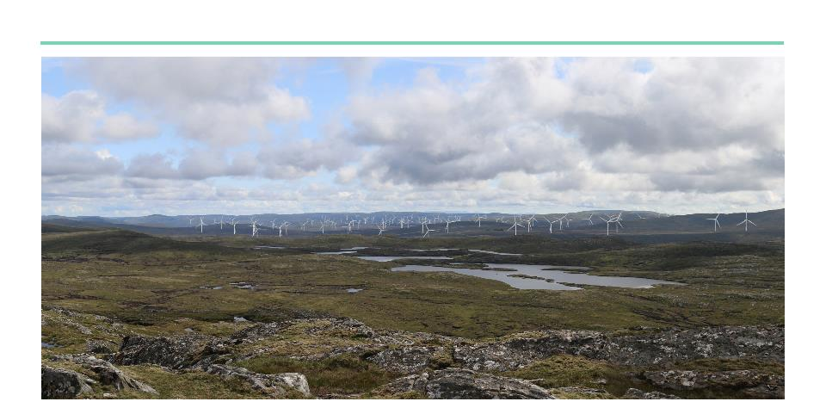
478 MW Renewable Energy site: (100MW operational hydro, 228MW operational wind, and 150MW proposed wind).

Slide 14
ASH design + assessment
21 Gordon Street, Glasgow G1 3PL
Tel: 0141 227 3388
info@ashglasgow.com

