Slide 1
Developing the UK’s Clean & Resilient PEMD Supply Chains
Driving the Electric Revolution
Mark Urbanowski
November 2020
© UKRI 2020

Slide 2
Industrial Strategy Challenge Fund
AI and data economy
Ageing
society
Clean growth
Future of mobility
Putting the UK at the forefront of the artificial intelligence and data revolution
Harnessing the power of innovation to help meet the needs of an ageing society
Maximising the advantages for UK industry from the global shift to clean growth
Becoming a world leader in shaping the future of mobility
£2.5 billion budget | 738 funded projects | 1415 organisations supported

Slide 3
Driving the Electric Revolution
Funding for industry
Investing £80m of ISCF funding for R&D projects, accelerating and de-risking business innovation
Networking and collaboration
Connecting industry, academia, RTOs & the government to ensure cooperation & collaboration to efficiently use solutions across the UK
Industrialisation and manufacturing
Leverage the UK’s world leading research capability in PEMD to create the supply chains necessary to manufacture PEMD products
Talent growth
Define & fill the PEMD skills gap by training, upskilling & reskilling to grow an evolving PEMD workforce across all levels
Power Electronics, Electric Machines and Drives (PEMD)
Identify key gaps in the UK PEMD supply chain and help industry fill them enabling delivery of Net Zero

Slide 4
Green and Resilient Recovery
The future of industry
Accelerating business innovation & leveraging private sector investment in research and development
Green recovery
Enabling economic growth opportunities from the shift to Net Zero carbon emissions
Backing new businesses
Catalysing the UK’s SME community as the best place to start and scale PEMD businesses
Increasing opportunity
Supporting level up economic performance across the UK, including through talent growth
The UK open for business
Growing more high value investment for PEMD in the UK
Notes:
Talent attracts inward investment

Slide 5
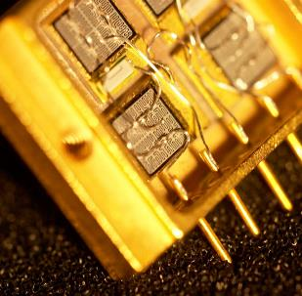
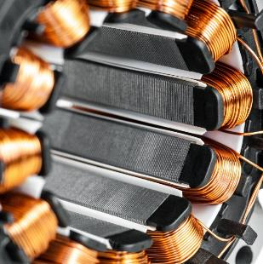
What is PEMD?
Power Electronics
Machines
Drives
Development of semiconductors (e.g. Si, SiC, GaN) and their packaging to enable switching of high power (voltage and/or current) whilst minimising loss
Conversion between electrical energy and kinetic energy through electromagnetic, mechanical and thermal design optimised for each application
Intelligent digital control systems embracing power electronics, passive components, thermal management, mechanical design and the overall system

Slide 6
Notes:
Cross Sector
* Maximise productivity
* Enable cross fertilisation
* Secure sufficient capacity

Slide 7
Whole Development Process | Life Cycle
Raw Mineral
Processed Material
Sub-component
Component
System Integration
Use & Recycling
Notes:
This covers motors in respect of mine the ore, create refined powder, converter powder into magnet including other elements, Take magnet and insert into rotor and then rotor into motor for final assembly. Regarding PE, this will be from growing the crystal ingot through fracturing individual wafers from it , doping it, metallisation, then whole aspect of packaging (I think CASC are present so point people at them.
Needs new background
This is key to engaging the audience at a materials event with DER – we care about their needs, not just the final product that is made
Covering full PEMD lifecycle from new materials to manufacturing
Driving innovation beyond our international competitors

Slide 8
Driving the Electric Revolution Investment
Driving the Electric Revolution challenge funding distributed to industry through tailored programmes
addressing key opportunities in the UK PEMD supply chain: R&D, collaboration, talent, equipment & expertise
£7m
Fast start accelerated supply chain CR&D activities
£5m
Short, high impact, high resilience supply chain CR&D projects
£20m
Flagship programme for high value/low volume &
high volume/high efficiency manufacturing supply chain CR&D projects
£6m
Initiatives in addressing the skills gap through
training, upskilling and reskilling
£30m
Industrialisation centres supporting industrial engagement with new equipment & expertise in PEMD scale up & manufacturing

Slide 9
DER – Industrialisation Centres
Investment & Growth
Industrial Engagement
Equipment & Expertise
Scotland The National Manufacturing Institute Scotland and the Power Networks Demonstration Centre, Glasgow
High Power PEMD, MW-scale Machines & Drives, Prototype & Scale Up, MW-scale Testing
North East The Innovation Centre NE, Sunderland
Prototype and Scale up of motors and drives, integration and QA & testing
Midlands Universities of Nottingham and Warwick
Machines Manufacturing Processes and Power Electronics Manufacturing Processes
South West & Wales The Compound Semiconductor Application Catapult Innovation Centre, Newport
Materials (Semiconductors, Magnets, Insulation and Components)
Notes:
Lose skills bit – change to equipment

Slide 10
Mark Urbanowski
Innovation Lead
Driving the Electric Revolution
mark.urbanowski@innovateuk.ukri.org
M +44 (0) 7725 484 669
www.ukri.org
Join us on the path to Net Zero
Polaris House, North Star Avenue
Swindon, SN2 1ET

