Slide 1
Speed and Scale II The race for hydrogen
November 2020
Restricted

Slide 2

What Net Zero by 2050 means for the UK
Grows 2-4 times
All carbon neutral
Electricity System
Freight
0 ➢ 180
Mt/y CO₂ Mt/y CO₂
Installed in 29 million existing homes
CCS
Low carbon heat
12 ➢ 75-100
GW GW
250,000 ➢ 35 million
Offshore Wind
Zero carbon cars
27TWh ➢ 370TWh
(grey) (green & blue)
Beef, lamb and dairy consumption halved
Hydrogen Production
Changes to diet
10,000 ➢ 50,000 ha ha
Large scale change affecting 20% of agricultural land
Afforestation
Landscape change
Figures adapted from The Committee on Climate Change
Notes:
This is a great business opportunity

Slide 3


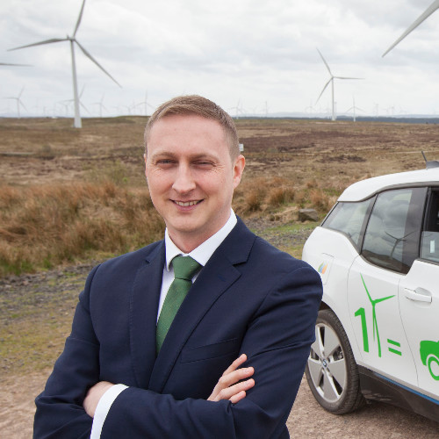


Speed and Scale - The race for hydrogen speakers
Matthew Knight
Head of Business Development
Siemens Energy
Benj Sykes
VP, Offshore
Ørsted
Barry Carruthers
Hydrogen Director
ScottishPower
Clare Jackson
Senior Consultant, Ecuity & Programme Manager
Hydrogen Hub
Rita Wadey
Deputy Director, Hydrogen Economy
Department for Business, Energy and Industrial Strategy (BEIS)
Notes:
This is a great business opportunity

Slide 4


Building a UK hydrogen economy
Pathfinder funding for electrolyser projects
Annual calls for electrolyser projects create a visible pipeline of work to build supply chain and reduce costs
Market mechanism for low CO₂ dispatchable power for Wind to H₂
Target 6-10GW H₂ production by 2030
Target 200-500TWh H₂ each year by 2050
Aspiration 200-500TWh H₂ each year by 2050
1-20MW electrolyser projects
50-100MW electrolyser projects
1st offshore wind to H₂ electrolyser project
>100MW electrolyser projects
GW scale wind to H2 projects
Investment in skills & supply chain
Electrolyser factory & wind to H₂ investment decisions
2020
2021
2022
2023
2027
2030
2040
2050
CCS cluster
FEED studies
Up to 20% H₂
in gas network
1st CCS cluster & H₂ power station investment decisions
1st 100% H₂
in homes
100% H₂
gas turbines
1st cluster carbon store opens
(100MW scale)
1st 100% H₂ power station
2nd cluster carbon store opens
ISCF Hydeploy Industrial fuel switching Etc.
GW scale reformer+ CCS projects
CCUS support mechanism
Green gas obligation
End dates for coal generation, petrol & diesel cars, natural gas boilers
FEED match funding
GHG labelling
Amend gas regulations
Large-scale H2 test facility
Target date for net zero electricity system
Unrestricted

Slide 5
Cost reduction for hydrogen from electrolysers
Modern ‘PEM*’ electrolysers are a new industry with significant scope for cost reduction
Research on PEM began in 1970s
First commercial product at >1MW scale 2015
Until recently every unit was ‘hand-built’
This industry has just reached the
‘model T Ford stage’
Cost reduction is a function of deployment
Evidence from many technologies including solar PV, batteries and wind power shows that system costs fall as a function of deployment. (Not time or R&D spend)
All the same factors apply to hydrogen from electrolysis
*PEM = Proton exchange membrane – a special electrolyte ‘sieve’ which allows hydrogen atoms
to pass through but not oxygen or water.
Cost Driver (in order of impact) | How this reduces with deployment
Cost of electricity | Renewable energy costs are reducing with their own deployment
Cost of finance | As experience is gained investors will reduce the risk premium
Cost of electrolyser | Technology improvement, Factory production methods, Economies of scale
Cost of installation | Learning by doing
Cost of compression | New electrolyser designs that work at pressure. (it’s much easier to pressurise liquid water than gaseous hydrogen)

Slide 6
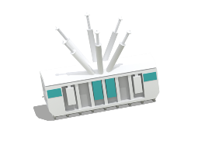
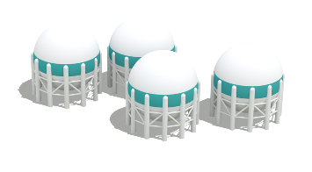

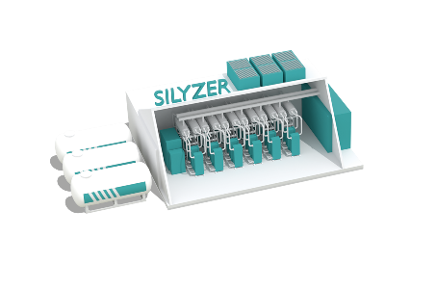


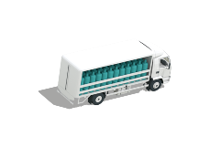

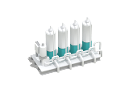
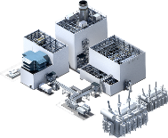
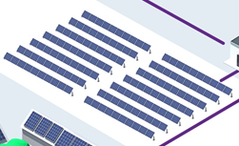
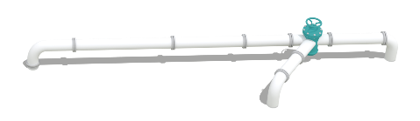
Hydrogen economy
More than just electrolyzers and ATRs
Use cases
High Voltage Transformer
Storage
Cooling
Medium Voltage Transformer
and Rectifier
Control
system
Buffer
Electrolyzer
Infrastructure/
Logistics
Compression
Water treatment
Gas purification
Civil Work
Siemens Energy is a registered trademark licensed by Siemens AG.
Notes:
Not a commodity – value depends on use
A vector to store and deliver energy for a wide range of use cases. Each one of which has incumbent fossil based alternatives.
To displace those incumbents need to create end to end business models.
Create compelling reasons for customers to switch
Calls for partnering and market shaping

