Slide 1
Hydrogen – Update from BEIS
Rita Wadey - Deputy Director, Hydrogen Economy

Slide 2
What I will cover today
UK context
Hydrogen Strategy
Production: twin track approach
Funding landscape
Stakeholder input
Next steps

Slide 3
UK context
Consensus of Views
National Grid’s annual Future Energy Scenarios (July): Hydrogen and carbon capture and storage must be deployed for net zero. H2 provides between 152 - 591TWh by 2050,.
Aurora: 2050 scenarios range from 210-500TWh, mix of green & blue H2
UK H&FC Research Hub: H2 consumption by 2050 120-750TWh.
Bloomberg (May): Meeting climate targets likely to require a clean molecule, especially for the hard-to-abate sectors. Hydrogen could meet up to 24% of the world's energy needs by 2050.
UK has set benchmark by legislating for net zero – hydrogen critical to achieving this
BEIS and CCC analysis shows significant amounts of low carbon hydrogen in energy system in order to meet net zero (BEIS: 150-450TWh by 2050)
Corroborated by a range of external reports
UK geography, geology, history & institutional arrangements offer specific advantages
UK has lots of good use cases for hydrogen in a variety of end use sectors: industry, power, heating, transport

Slide 4
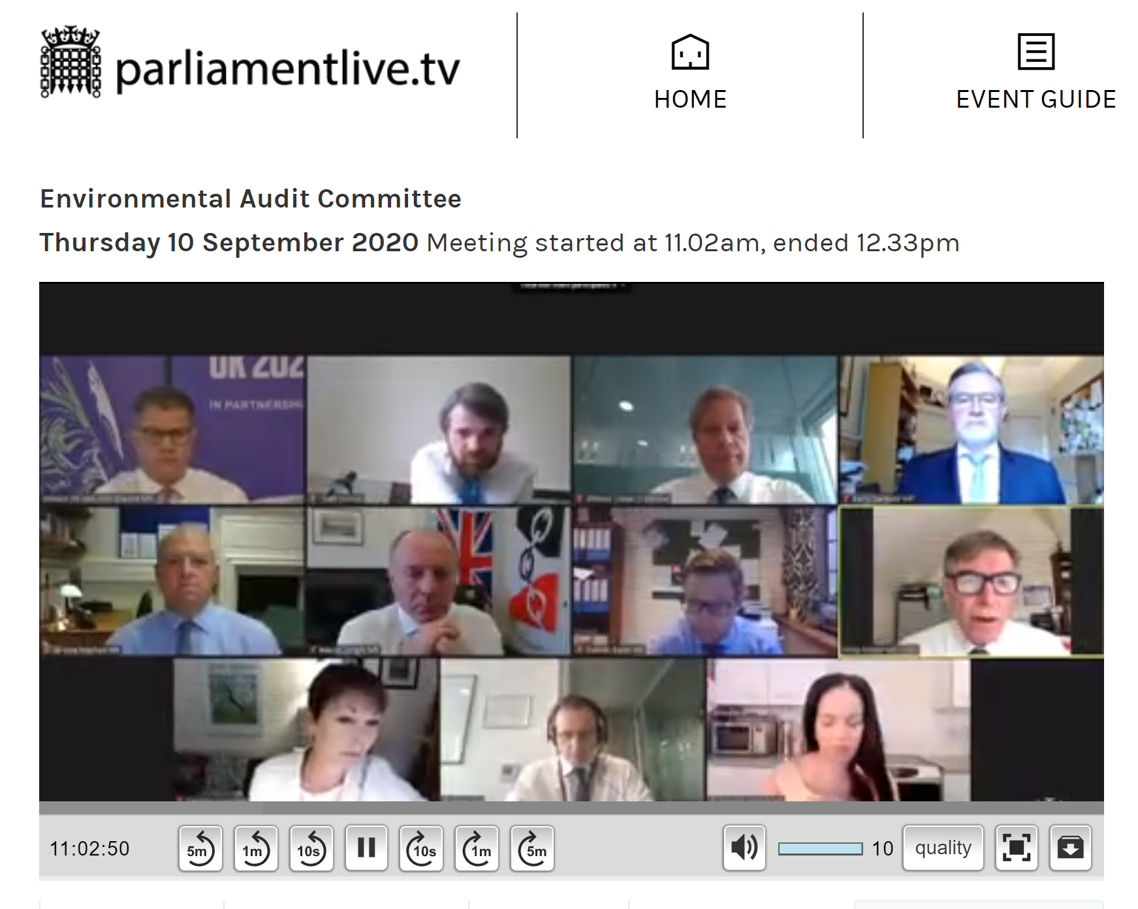
UK Hydrogen Strategy
Development of the UK strategy is well underway, working closely with Minister Kwarteng
Expect to cover:
Case for hydrogen in UK context, HMG vision
Whole system view (supply through to demand)
Action required in 2020s, including laying ground for ramp up beyond 2030
Economic benefits for UK
Role of various actors
Whole UK view
BEIS Secretary of State Alok Sharma publicly commits to publish a UK Hydrogen Strategy in early 2021
(EAC hearing 10/09)

Slide 5
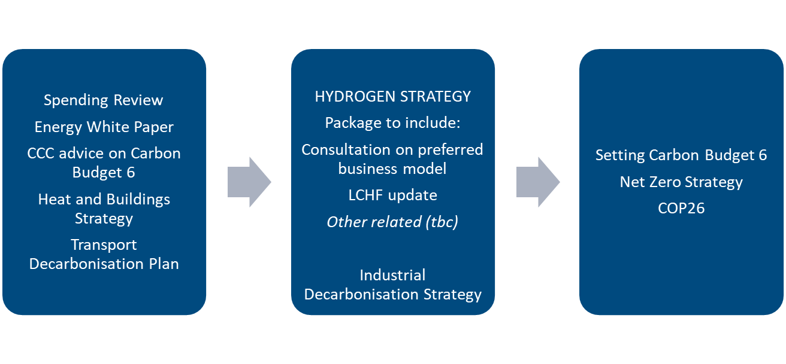
Sequencing
Spring publication supports alignment with broader activity and allows time for engagement
Late 2020
Spring 2021
2021

Slide 6
Production: twin track approach
Not blue or green, both
Low carbon hydrogen at scale in 2020s; volumes that support innovation and investment across the value chain
Scale up of renewable hydrogen
Pathway to net zero
Approach informs
Innovation (to date & future)
Low Carbon Hydrogen Fund development
Business model development
Strategy development
“By 2050, a new low-carbon industry is needed, with UK hydrogen production capacity of comparable size to the UK's current fleet of gas-fired power stations.”
CCC: Reducing UK emissions: 2020 Progress Report to Parliament

Slide 7
Funding landscape – current and future
Production | Storage | Distribution | End Use
H2 Supply (£33m) To accelerate development of bulk low carbon H2 supply solutions, including storage |  | HyDeploy/HyDeploy 2 (~£7.3M) To demonstrate safety case for blending up to 20% H2 into grid | Hy4Heat (£25m) To explore safety of 100% H2 for heating (including H2 quality recommendation, development & testing of domestic H2 appliances and safety testing & QRA)
Closely related: £34m CCUS funding, £24m CCUS Innovation Programme, £10m CCUS International Collaboration | Storage at Scale (£20m) To demonstrate innovative large-scale energy storage, including Power-to-X technologies | Network Innovation (~£10.3m) To establish technical and economic feasibility for H2 conversion of grid | Industrial Fuel Switching (£20m) To stimulate early investment fuel switching processes and technologies, including H2
FUTURE (Announced) Net Zero Innovation Fund £1bn Budget20 Anticipate support for H2 (tbc) |  |  | H2 for Transport (£23m) To develop UK H2 vehicle market, deployment of vehicles & infrastructure - DEPLOYMENT
CCS Infrastructure Fund at least £800m Budget20 Enabler - DEPLOYMENT
Low Carbon H2 Production Fund £100m To deploy production capacity & encourage private sector investment - DEPLOYMENT |  |  | Industrial Energy Transformation Fund (£315m) and Industrial Clusters Mission / ISCF (£170m) Decarbonisation funds, could support fuel switching to H2 - DEPLOYMENT
Current HMG Funding
Future HMG Funding
Ofgem/Industry Funding
Plus a range of feasibility studies from industry and regional partners e.g. HyNet NW, H21 North of England (various funding sources); and from UKRI.
Notes:
Innovation Funding supports activity across the H2 value chain underpinning future deployment funds
Spending Review

Slide 8
Stakeholder Input
Hydrogen Advisory Council
To inform development of strategic approach to hydrogen
HAC Working Groups
Supports delivery of HAC priorities, whole system approach
Co-chaired by Minister Kwarteng and Sinead Lynch, UK Country Chair for Shell
Launched in July, second meeting 14th October
Expected to run for two years; initial focus production
Membership will be kept under review in line with priorities
Complement to other related HMG/Industry groups
Broader membership working closely with officials
2020s Deployment Roadmap
Sector Development – supply chain, skills and jobs, export opportunities
R&D & Innovation
Standards and Regulations
Business Models Expert Group (already established)
Notes:
Code for Strategy
Meet roughly quarterly
Note high level of interest in being a member
Membership tight in line with Ministerial wishes

Slide 9
Next steps
HAC working groups – from November
Update on business models – by end 2020
Engagement on LCHF – from late 2020
Engagement on strategy development – ongoing
Hydrogen Strategy publication – spring 2021
‘Minded to’ consultation on hydrogen business models – alongside strategy

Slide 10
Contacts:
rita.wadey@beis.gov.uk
ie.hydrogen@beis.gov.uk

