Slide 1
Prospering from the Energy Revolution: Building local foundations for Net Zero.
Rob Saunders
PFER Challenge Director, UKRI

Slide 2
The Revolution is Now!
This Photo by Unknown Author is licensed under CC BY-NC-ND
Notes:
The energy revolution is happening – just look at coal, oil vs solar and wind.
Not just tech substitution, it’s blowing apart the nice neat centralised system into a million different pieces all over the place.
But the good news is, it’s going to be cleaner and cheaper – if we can find the right ways to organise it!
That’s what this programme aims to do – put all the bits of the future system together intelligently so we can all live better net zero lives without worrying!

Slide 3
WHY
LOCAL ?
Notes:
Local because
Technically – cheaper cleaner tech is more distributed.
- Heat is inherently local – we can’t pump that far
- demand, flexibility is local first and foremost.
Economics - Local systems mean local jobs & therefore fairer systems balanced across the country
- balancing the system locally means we can save £bns on upgrades that aren’t needed – saving bills.
- Coordinating across power, heat, mobility, supply, demand creates flexible efficicency. But can only do locally.
People - We all live locally – and the systems need optimising for our locality and our lives
- Trust and engagement in change are better enabled locally than imposed nationally. This is going to be incredibly important in getting to net zero.

Slide 4
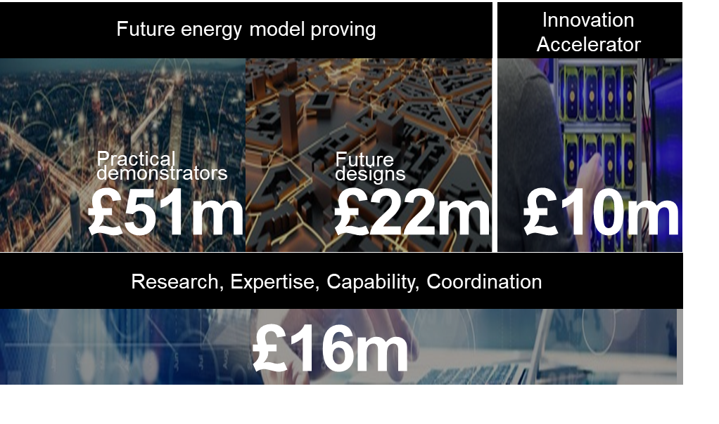
Prospering from the Energy Revolution
Objectives
Prove Investible Scalable Local Energy Business Models
Unlock Finance
Accelerate New Products & Services to Commercialisation
Build UK Leadership
Future energy model proving
Activities
Notes:
Programme Objectives translate into a set of activities.

Slide 5
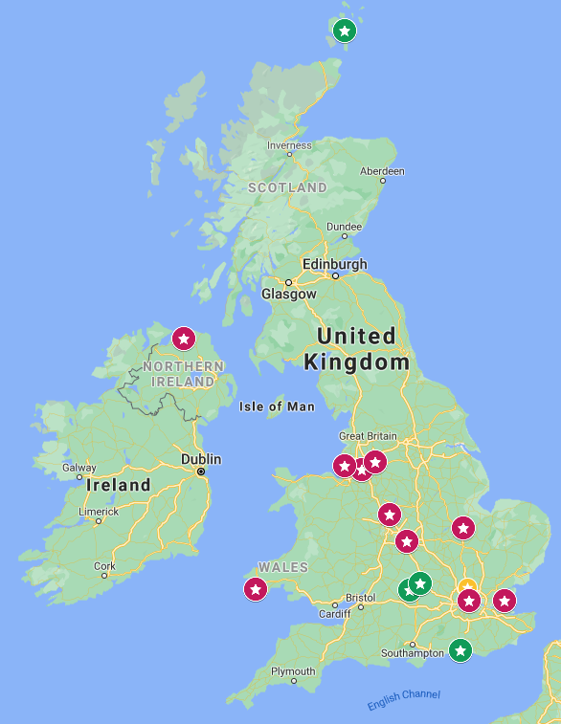
A portfolio of groundbreaking local projects
Demonstrators (half-way through)
Detailed Designs (just starting)

Slide 6
Demonstrating…
Town-Scale power, heat and mobility services
Integrated intelligently to please consumers
In scalable, replicable and investable models

Slide 7
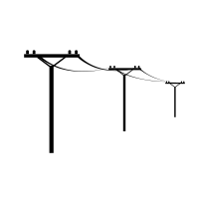
Around Oxford: Complementary approaches
Hybrid Grid-scale storage
EV charging at scale:
25MW ultra-rapid charging for private cars & city fleets.
Ground source heat pumps Novel shared loop + ‘shoebox’ HPs.
2MW Invinity flow battery
50MW Lithium ion battery
Optimisation and trading, machine learning-based
Direct transmission connection at Cowley substation, South Oxford

Slide 8
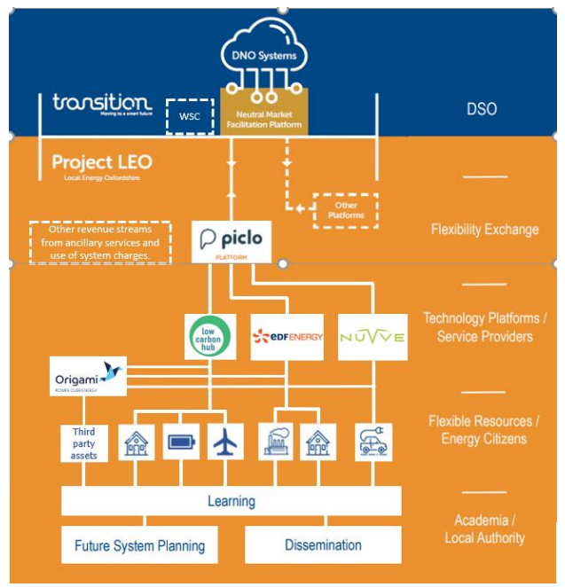
Around Oxford: Complementary approaches
Data-rich, intelligent local grid, acting as neutral market enabler…..
…of competitive market services that people want and that maximise use of local net zero resources…
…in an agile, learn-as-you-go way.

Slide 10
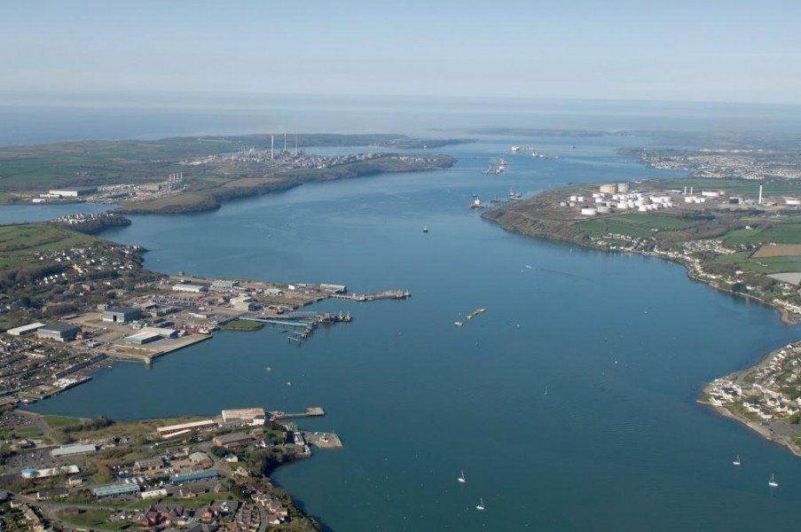
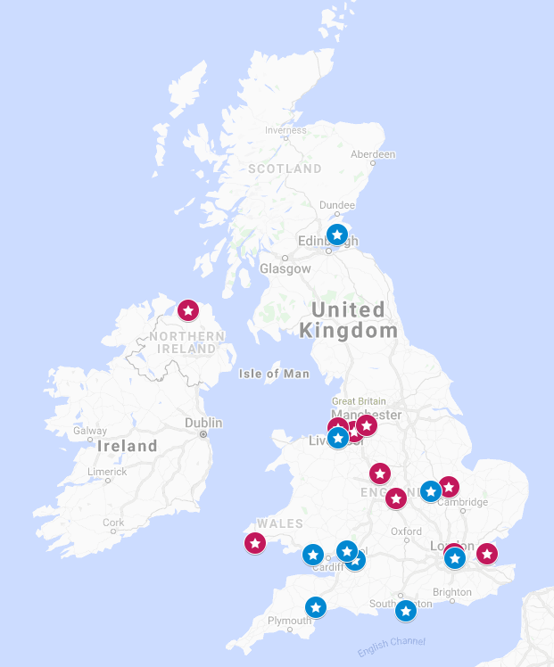

Slide 11
This Photo by Unknown Author is licensed under CC BY-SA

Slide 12
Thankyou @RobS_energy rob.saunders@innovateuk.ukri.org

