Slide 1
Energy Integration in Action
From Oil & Gas to Energy Integration
Scott Robertson, Operations Director
5th October 2021

Slide 2
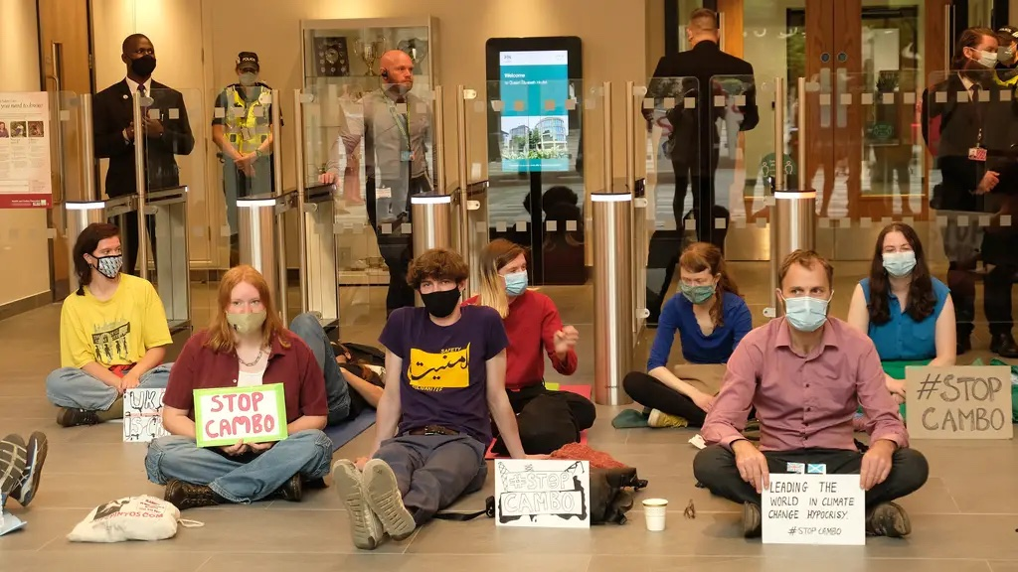
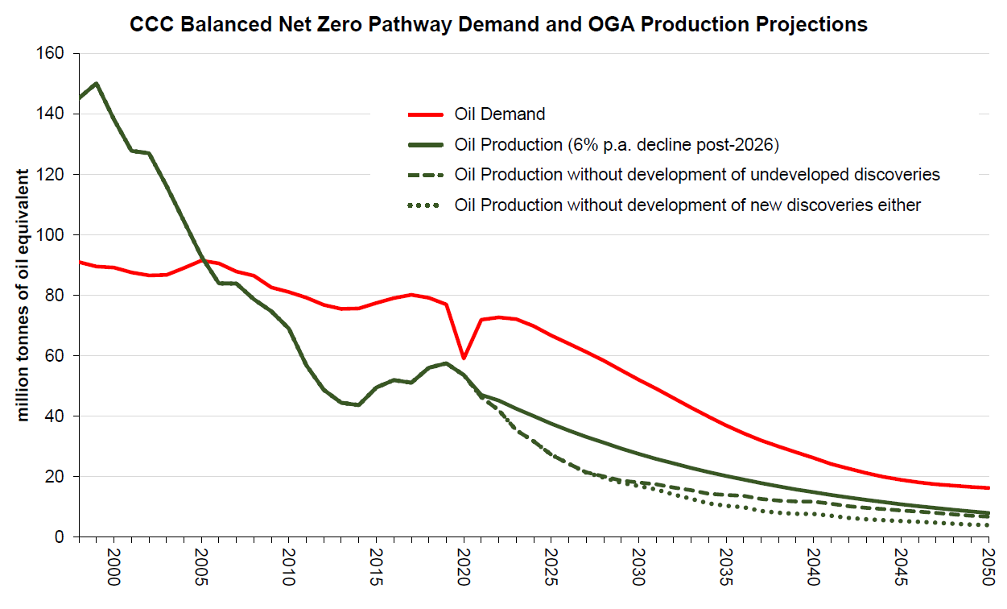
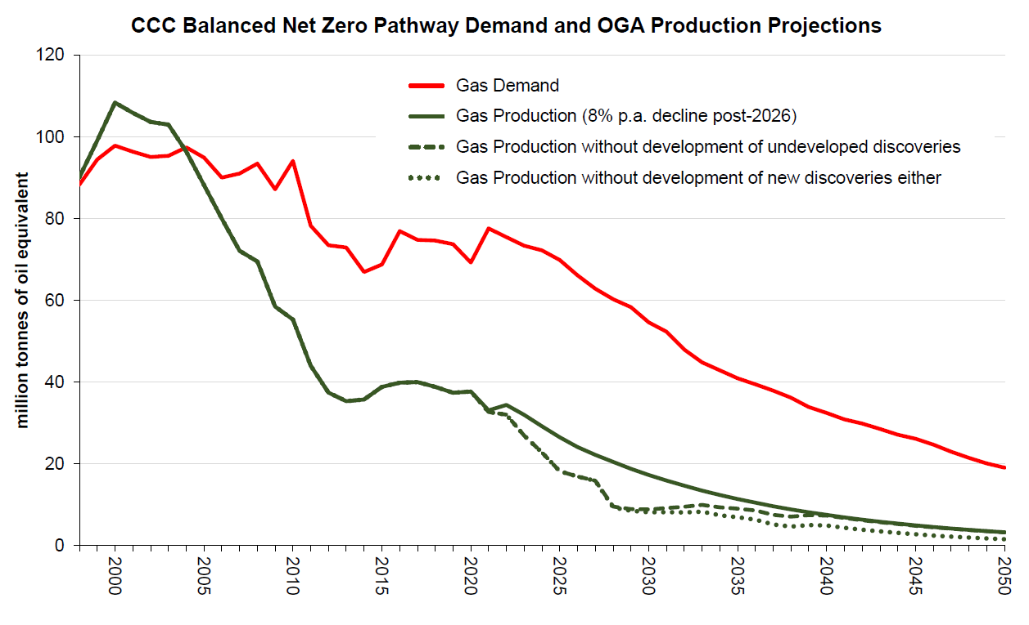
Oil and gas under the spotlight
Oil & gas meets
c.¾
UK energy demand
-33%
Reserves replacement

Slide 3
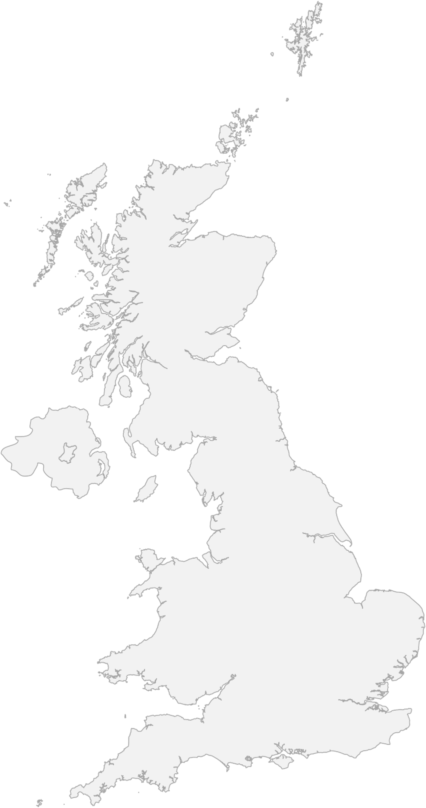
Offshore contribution to UK net zero
Onshore CO₂ emissions
15 largest UK emitters (areas with 30km radius)
Orion
Shetland renewable energy hub
30
mtCO₂ pa
10
2050 net zero emission abatement from 2018 baseline
Source: NAEI 2019 data, OGA analysis
Note: total CO2 emissions on the map account for ca.186 mtCO₂ (~40% of UK total)
Acorn
4
2 Mtpa from mid 2026 (with blue H2);
7 Mtpa by 2030
Re-uses existing infrastructure
~30%
9
Energy Integration technologies
6
6
5
7
Endurance CCS
(Teeside & Humber clusters)
Hynet
9
4 Mtpa from 2026
10 Mtpa by 2030
1 Mtpa from mid 2025;
3 Mtpa by 2030 (with blue H2)
Re-uses existing infrastructure
25
~60%
12
24
15
UKCS Contribution
Offshore net zero projects (ongoing)
Bacton Hydrogen
15
Linked to BEIS priority clusters
30
Early stage, potential for H2 supply into London area
Further projects
9
CCS
CCS / Blue H2
11
Green H2

Slide 4
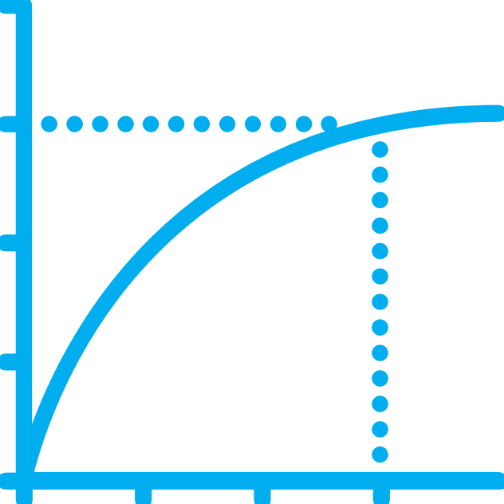
Use the colour picker or type in the RGB values to select colour.
North Sea Transition Deal
OGA colour family R-G-B
NSTD: £16bn investment committed
Influence: R0 G174 B239
Govt & industry commitment to transition
First of kind for G7 country
Future licensing climate checkpoint
Quid pro quo
Promote: R0 G101 B162
£10bn for hydrogen
£3bn for electrification
Regulate: R312 G50 B155
Right conditions: R166 G25 B46
Technology/data: R239 G130 B0
£3bn for CCS
Asset stewardship: R154 G149 B0
Exploration: R72 G168 B66
Decom: R0 G184 B176
50% local content
Supply Chain Champion
People/process: R99 G102 B106
Industry commitment to reducing upstream GHG emissions
OGA tracking and monitoring progress
10%
25%
2025
2027
90%
Annual OGA dashboard
Overall KPI target progress
50%
GHG target
as OGA KPI
Intensity benchmarks
Flaring & venting
2030
Net zero basin

Slide 5
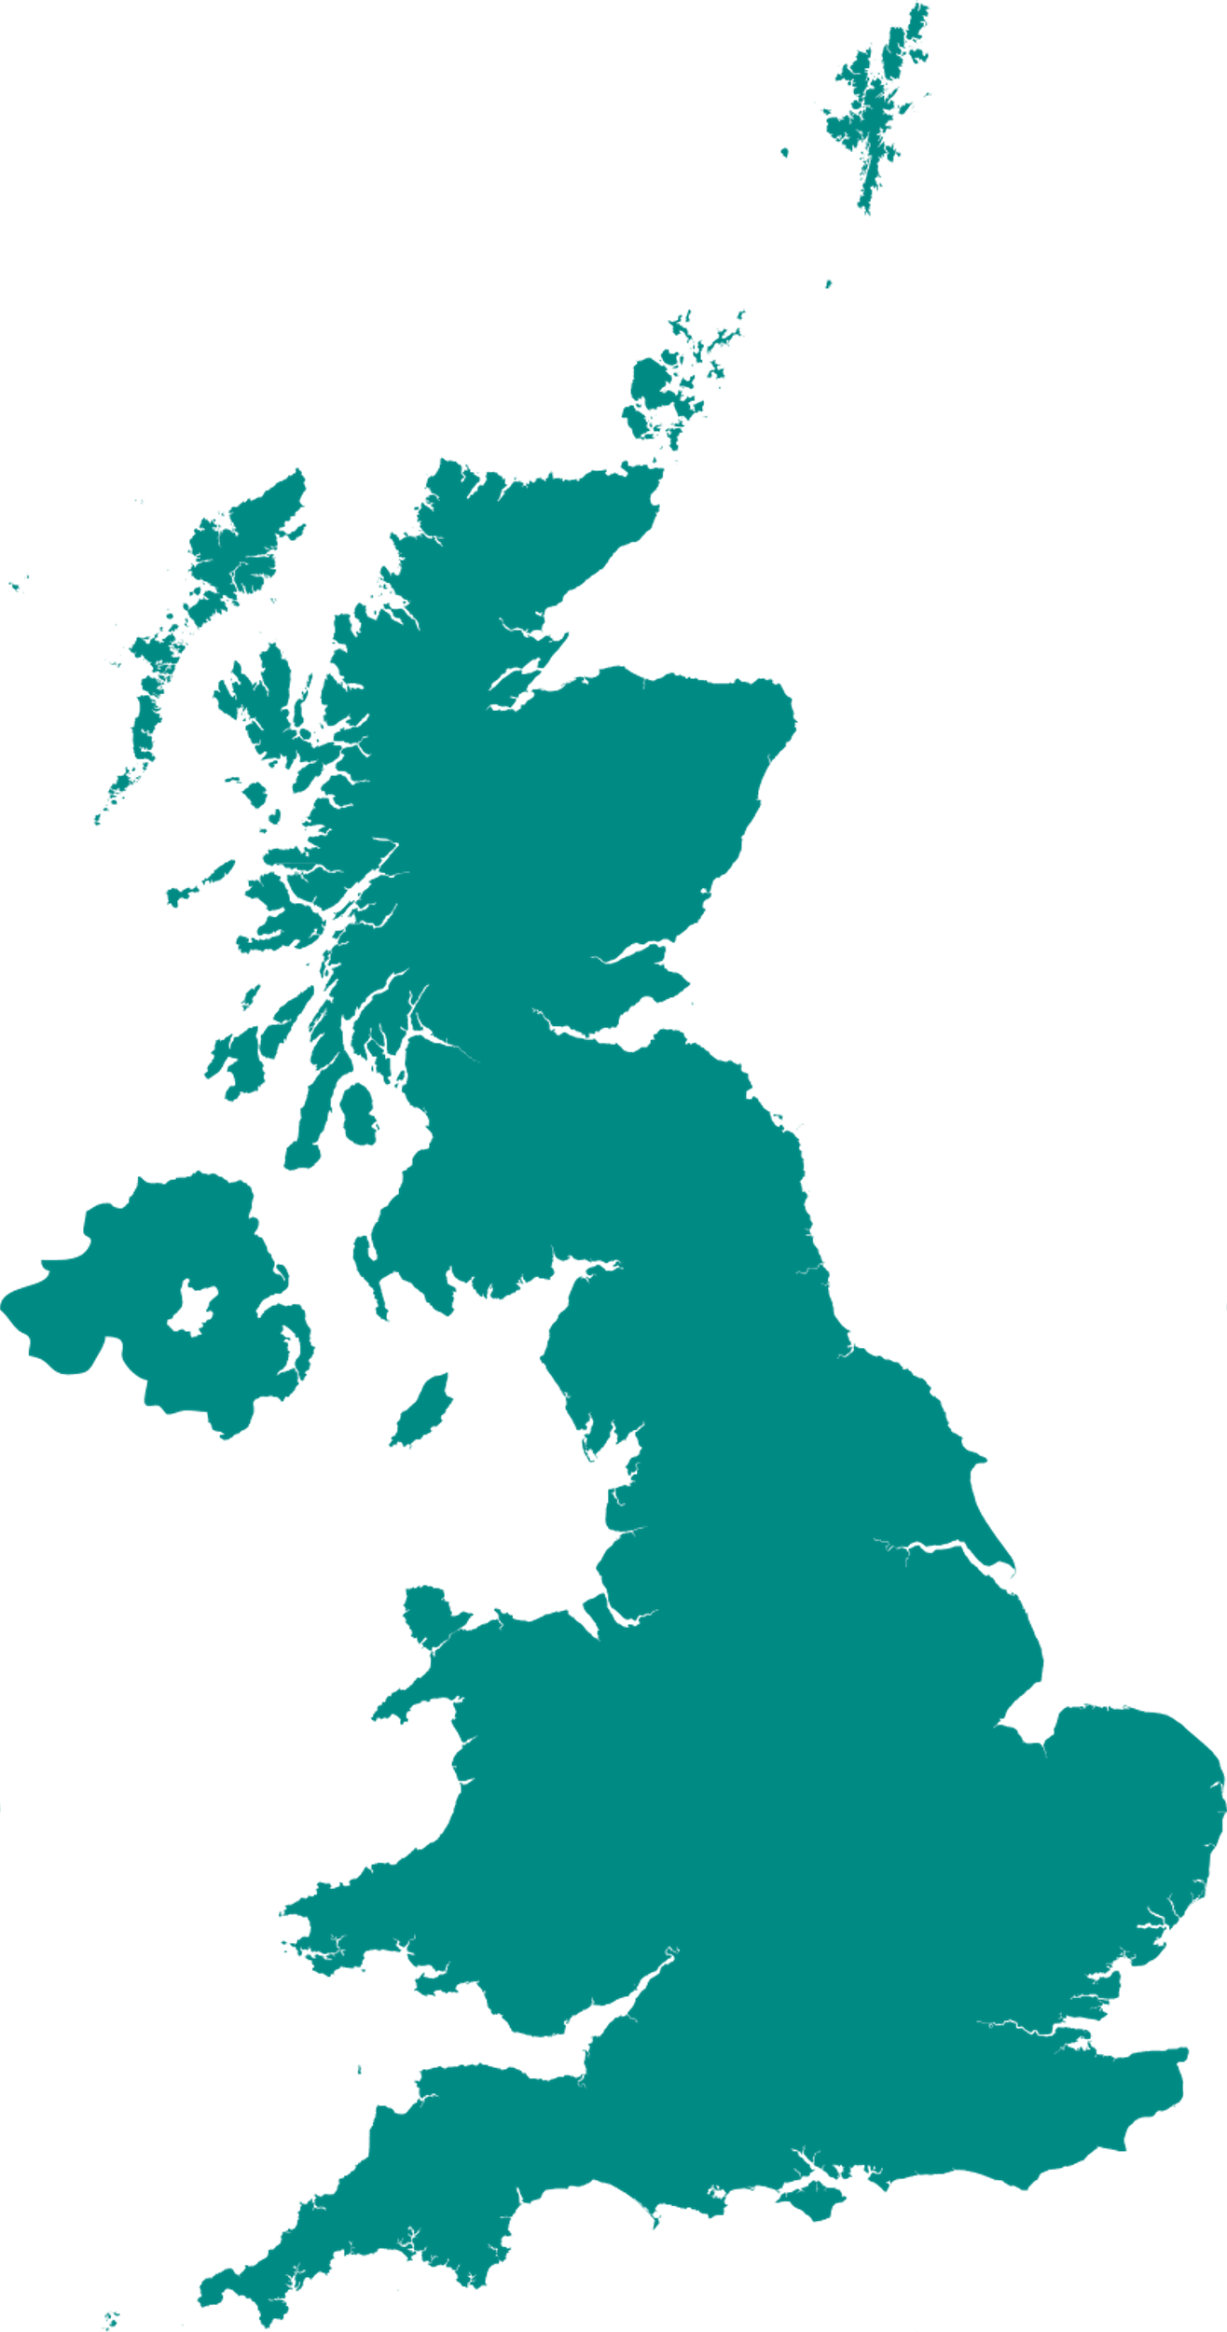
Electrification is crucial
Expected Timeline
Hitting emissions reduction targets
2050
Net Zero
Critical to 25% emissions reduction target by 2027
UKCS emission abatement opportunity (OGA, EIP)
~
~
NNS
2030
-50% Emissions Reduction
Zero Routine Flaring
WoS
More collaboration required, at pace
Alignment between partners, governments and other sectors
Regional schemes in CNS & WoS
2027
-25% Emissions Reduction
CNS
EIS
SNS
2025
-10% Emissions Reduction
Infrastructure legacy
Investment in offshore transmission
Grid capacity expansion
Supporting offshore wind growth (+30GW by 2030, and 1GW floating wind)
1
Average Power Demand (MW)
10
100
2022
Concept select
2021
O&G / Power engagement & workshops
2020

Slide 6
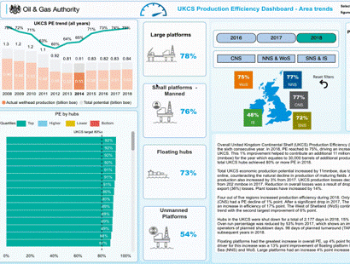
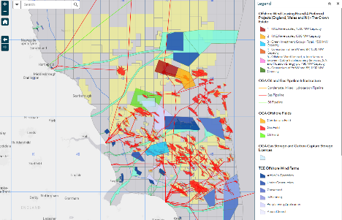
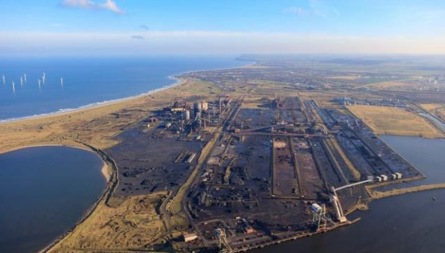
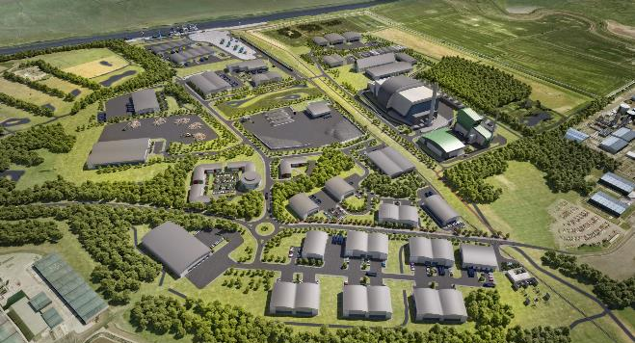
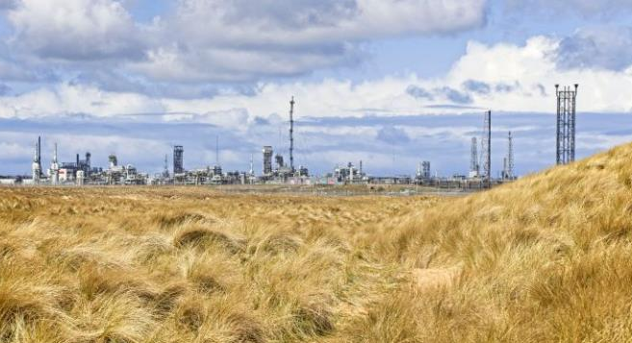
CCS – the time is now
Unlocking value through data & digital
CCS Projects
Balanced Net Zero Pathway
78
GtCO₂
Total UKCS CO₂ storage resource estimate
National Data Repository
Spatial planning to high-grade future sites
Geographic Information
Systems (GIS)
Insights & analysis
carbon storage licences being stewarded towards permit application and first CO₂ injection
Northern Endurance Partnership, Teesside
HyNet, North West England
Acorn, St Fergus
3
carbon storage licences being stewarded towards storage permit application and first CO₂ injection
3
carbon storage licences applications being assessed

Slide 7
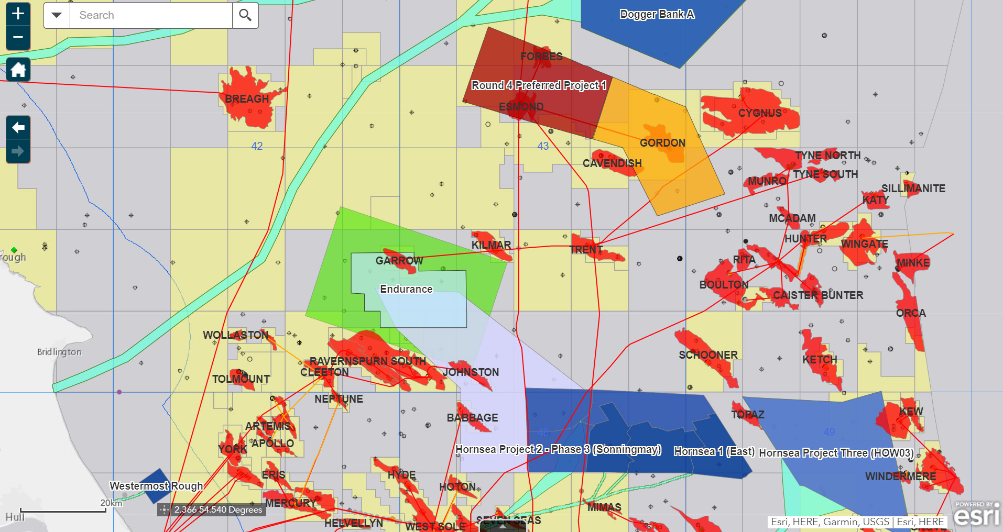
UKCS is "prime real estate"​
North Sea, East Irish Sea
becoming a crowded space for energy
Spatial planning for energy integration is critical
Close interactions across regulators

